Slide 1
Operating System

Slide 2
What is Operating System
OS is system software, which may be viewed as collection of software consisting of procedures for operating the computer.
It provides an environment for execution of programs (application software).
It’s an interface between user & computer.

Slide 3
Computer Machine (Hardware)
Machine Language (Low Level Language)
Operating System
Human Understandable Language (High Level Language)
User / Programmer

Slide 4
Types of OS
  Multiprogramming OS
  Multitasking/Multiprocessing
  Multiuser OS
  Time Sharing OS
  Real Time OS
  Distributed OS

Slide 5
A Second Classification
  This Classification is based on the type of interface Operating System provides for the user to work in.
    Character User Interface (CUI)
    The User has to type the commands on the command prompt to get the work completed.
    Ex. DOS, UNIX.
    Graphical User Interface (GUI)
      The User need not type any commands. He/She just point and clicks on the desired Icon to get the work done.
      Ex. Windows (9X, XP, NT, 2000), Linux.

Slide 6
Functions of OS
    File Management
    Memory Management
    Process Management
    Device Management

Slide 7
Types of Processing
  Serial Processing
  The job is processed at the time when it is submitted.
  Batch Processing
The similar jobs are bunched together and are kept for processing at an later time.

Slide 8
MS-DOS Overview
MS-DOS is an acronym for MicroSoft Disk Operating System
It is a CUI based operating system.
It provides user with a command prompt (generally called as C:\) where various command could be typed.
When one operates in the DOS environment, one interacts with the command interpreter, which interprets the commands given by user.
It provides an environment for execution of various application programs like MS-Word, MODBANKER, ISBS etc.

Slide 9
What is Command
It is a string of characters which tells the computer what to do.
When one types commands to a computer, one is conversing with the operating system's command interpreter.
For example, to copy a file called file.txt from the 3-1/2" floppy drive to the hard drive, one could type
C:\> copy a:\file.txt c:\
The word "copy" is a DOS command which causes files to be copied from one location to another

Slide 10
Entering the DOS Environment
If the OS is DOS then the system will directly show prompt (C:\>)
If the OS is windows one must either terminate the Windows environment, or open a DOS shell within the Windows environment.
Ist Method: Terminating Windows Environment
Select “Restart in MS-DOS Mode” from Shut Down in Start Menu.
IInd Method: Opening DOS Shell in Windows
Select Start>Programs>Accessories>Command Prompt (XP)
Start>Programs>Accessories>MS-DOS Prompt (98)

Slide 11
Files and Directory
Files
A file is a collection of Records.
It is the smallest unit of File System (Storage) in a computer.
Any document created using computer is a file. This document could either be a letter, any excel sheet, any image or even a database.
Directory
A collection of files is directory (in DOS) or folder (in Windows)
It is analogous to the Office Folder which contains various documents.
A directory/folder eases the management of related files/ documents, like the various circulars related to personnel could be placed in a directory called “personnel” and all the circulars related to loans could be placed in a directory called “loans”.

Slide 12
Filenames in DOS?
The filename in DOS have the following format.
<name>.<ext>
It has two parts the name and the extension.
The name could be of 8 characters and the extension of 3 characters.
The filename can contain alphabets and numbers. It cannot contain any special character other than underscore (_) and also no spaces.

Slide 13
Organization of files in DOS
  The DOS file system is a hierarchical file system.
  Files are collected into directories, and directories may contain both files and other directories.
  There is always a directory which is not contained by any other, called the root which is represented by the backslash '\' character.

Slide 14
Organization of files in DOS (Contd.)
  Concept of Path: Every file can be specified by enumerating all of the directories between the root and it, separated by the backslash '\' character, and appending the file name to the end.
  The drive which contains the root is specified at the head of the path, separated from the root by a colon (':')
  The hard drive is most commonly known as the C: drive, and the floppy drives are usually called A:(3-1/2 inch) and B: (5-1/4 inch).

Slide 15
Organization of files in DOS (Contd.)
/
circulars
loans
personnel
officer.txt
new.dat
january
february
retire.txt
Figure : Hierarchical Structure of Files
rest.txt
abc.txt

Slide 16
Some DOS Commands
dir: Listing of all the directories.
C:\> dir
cls: Clears the screen.
C:\> cls
copy con: Creates a file.
C:\> copy con <filename>
< Write your Contents Here>
Press Ctrl-Z (^Z) to finish writing.
Ex: C:\> copy con test.dat
Lets Make UCO a top class Bank.
Ctrl-Z (^Z)
1 file(s) copied. (A Message will be shown on the system)
This will create a file named test.dat having some data.

Slide 17
Some DOS Commands (Contd.)
edit: Edits a file.
C:\> edit <filename>
This will open a editor window where the contents of file can be seen. These contents could also be edited here and on saving, the contents of file will change.
type: Displays the content of a file.
C:\> type <filename>
This will display the contents of file on the computer. The contents of file could only be viewed but could not be changed, as in the case of edit.

Slide 18
Some DOS Commands (Contd.)
md: Make Directory.
C:\> md (directory name>
This will create a directory with the specified name.
cd: Change Directory.
C:\> cd (directory name>
This will change the directory from current directory to the specified directory.
rd: Remove Directory.
C:\> rd (directory name>
If the directory is needed to be removed permanently from the computer, use this command. For this command to be executed it is necessary that the directory should be empty and user should be on a directory above it.

Slide 19
Some DOS Commands (Contd.)
copy: Copies a file.
C:\> copy <source> <destination>
This will copy the file from the source location to the specified destination. The command creates a copy of the file on the destination i.e. the file would be found on both the location.
move: Moves a file.
C:\> move <source> <destination>
This will move the file from the source location to the specified destination. The file from the source location would be removed and would be moved to the destination.

Slide 20
Some DOS Commands (Contd.)
ren: Renames a file.
C:\> ren <old filename> <new filename>
This will change the name (rename) of the file to a new name as specified.
del: Deletes a file.
C:\> del <filename>
This will delete the file permanently from the system.

Slide 21
Overview of Windows
  Windows is an GUI based operating system.
  It is also developed by Microsoft Corporation, which is headed by Mr. Bill Gates.
  Over the years the Microsoft have evolved various versions of Windows. Win95, Win98, Win2000, Win ME, Win NT, Win XP.
  It gives user a handy environment where he doesn’t have to remember and learn the syntaxes of various commands as is the case in DOS.
  The user can just point and click on the Icons provided to him on the screen.

Slide 22
Folders and Documents
Folders are a way to organize your documents within drives in Windows as are the directories in DOS.
A document is each thing that you create on a computer. A document can be made using any type of software.
Notes:
Now click on the folder “From your Teacher”
Then click on the Document “Welcome to Class”
Explain the software program that was used to create this document.

Slide 23
UNIX
UNIX was originally developed in 1969 by Thomson and Ritchie of the Computer Science Research Group at Bell Laboratories. UNIX has gone through many versions since then. It has been a popular operating system among computer programmers and computer scientists.
UNIX is a multiuser, multiprocessing, portable operating system.
It is designed to facilitate programming, text processing and communication

Slide 24
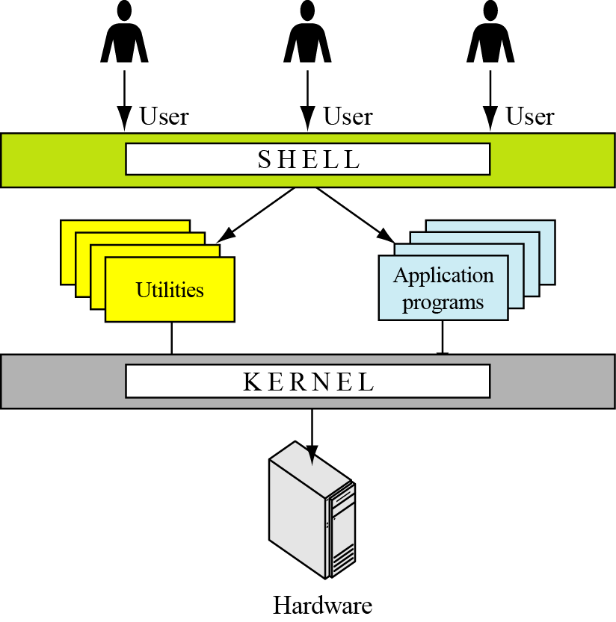
Figure: Components of the UNIX operating system

Slide 25
Linux
In 1991, Linus Torvalds, a Finish student at the University of Helsinki at the time, developed a new operating system that is known today as Linux. The initial kernel, which was similar to a small subset of UNIX, has grown into a full-scale operating system today. The Linux 2.0 kernel, released in 1997, was accepted as a commercial operating system: it has all features traditionally attributed to UNIX.

Slide 26
Windows NT/2000/XP
In the late 1980s Microsoft, under the leadership of Dave Cutler, started development of a new single-user operating system to replace MS-DOS (Microsoft Disk Operating System). Windows NT (NT standing for New Technology) was the result. Several versions of Windows NT followed and the name was changed to Windows 2000. Windows XP (XP stands for eXPerience) was released in 2001. We refer to all of these versions as Windows NT or just NT.

