Slide 1
DBMS
Deadlock

Slide 2
Deadlocks
Detection
  Wait-for graph
Prevention
  Resource ordering
  Timeout
  Wait-die
  Wound-wait

Slide 3
Deadlock Detection
Build Wait-For graph
Use lock table structures
Build incrementally or periodically
When cycle found, rollback victim
T2
T5
T1
T7
T4
T3
T6

Slide 4
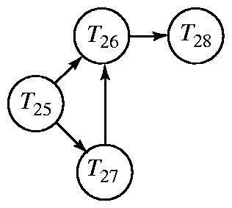
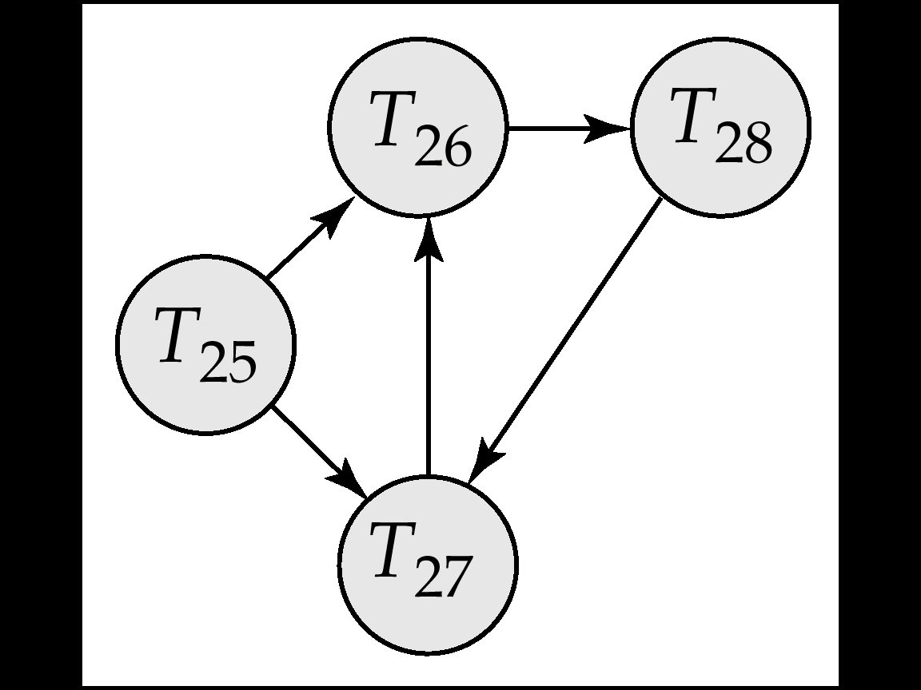
Deadlock Detection
Deadlocks can be described as a wait-for graph, which consists of a pair G = (V,E),
  V is a set of vertices (all the transactions in the system)
  E is a set of edges; each element is an ordered pair T_{i} →T_{j}.
If T_{i} → T_{j} is in E, then there is a directed edge from T_{i} to T_{j}
  implying that T_{i} is waiting for T_{j} to release a data item.
When T_{i} requests a data item held by T_{j}, then T_{i} → T_{j} is inserted in the wait-for graph.
  This edge is removed only when T_{j} is no longer holding a data item needed by T_{i}.
The system is in a deadlock state if and only if the wait-for graph has a cycle.
The system invokes a deadlock-detection algorithm periodically to look for cycles.
Wait-for graph without a cycle
Wait-for graph with a cycle

Slide 5
Deadlock Recovery
When deadlock is detected:
  Some transaction will have to rolled back (made a victim) to break deadlock.
    Select that transaction as victim that will incur minimum cost.
  Rollback -- determine how far to roll back transaction
    Total rollback: Abort the transaction and then restart it.
    Partial rollback: More effective to roll back transaction only as far as necessary to break deadlock.
  Starvation happens if same transaction is always chosen as victim.
    The system may include the number of rollbacks in the cost factor to avoid starvation

Slide 6
Deadlock Handling
System is deadlocked if there is a set of transactions such that every transaction in the set is waiting for another transaction in the set.
Deadlock prevention protocols ensure that the system will never enter into a deadlock state.
Some prevention strategies :
  Require that each transaction locks all its data items before it begins execution (predeclaration).
  Impose partial ordering of all data items
    require that a transaction can lock data items only in the order specified by the partial order (graph-based protocol).
  Timeout-Based Schemes :
    a transaction waits for a lock only for a specified amount of time.
      After the wait time is out and the transaction is rolled back. (No deadlock!)
    simple to implement; but starvation is possible
    Also difficult to determine good value of the timeout interval.
  Use timestamping (in the next slide)

Slide 7
Deadlock Handling
Consider the following two transactions:
T₁: write (X) T₂: write(Y)
write(Y) write(X)
Schedule with deadlock
T₁
T₂
lock-X on X
write (X)
lock-X on Y
write (Y)
wait for lock-X on X
write(X)
wait for lock-X on Y
write(Y)

Slide 8
Deadlock Prevention with Timestamps
Following schemes use transaction timestamps for the sake of deadlock prevention alone.
Wait-die scheme — non-preemptive
  Older transaction may wait for younger one to release data item.
  Younger transactions never wait for older ones; they are rolled back instead.
  A transaction may die several times before acquiring needed data item
Wound-wait scheme — preemptive
  Older transaction wounds (forces rollback of) younger transaction instead of waiting for it.
  Younger transactions may wait for older ones.
  May be fewer rollbacks than wait-die scheme.
Both in wait-die and in wound-wait schemes, a rolled back transaction is restarted with its original timestamp.
  Older transactions thus have precedence over newer ones in these schemes, and starvation is hence avoided.

Slide 9
Deadlock in DBMSs
What is a deadlock?
  A cycle of transactions, T₁, T₂, ... , T_{n}=T₁ where each T_{i} is waiting for T_{i-1} to release a lock.
  Causes these transactions to sleep forever.
A Deadlock can happen whenever you allow a transaction to wait for a lock, even with strict two phase locking.
  Simple example:
Users can eliminate deadlocks by accessing resources in a fixed order.
DBMSs typically detect deadlocks and abort the transaction that (it thinks) has used the least resources.
T1: R(B), W(A)
T2: R(A), W(B)

Slide 10
Review: The ACID properties
Recovery
System
Atomicity: All actions in the transaction happen in their
entirety or none of them happen.
Consistency: If each transaction is consistent, and the DB
starts in a consistent state, it ends in a consistent state.
Isolation: Execution of one transaction is isolated from that of other transactions.
Durability: If a transaction commits, its effects persist.
Programmers
Concurrency
Control
System
Recovery
System

