Slide 1
VISUAL MEDIA
FUNCTIONAL ENGLISH
B.A.II
CAMERA
ANATOMY AND FUNCTIONING
Jasreet kaur
Dept. of English

Slide 2
it is imperative for the script writer ( TV) to learn to think visually.
Camera is the visual navigator
Images are shown as captured by the camera.

Slide 3
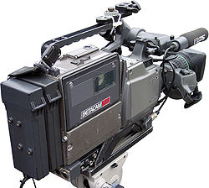
VIDEO CAMERAS
Available in various shapes and sizes
Combo Camera includes video track recording (VTR) system
Beta Cam SP Digital is the most sophisticated camcorder

Slide 4
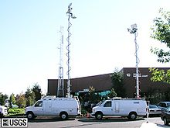
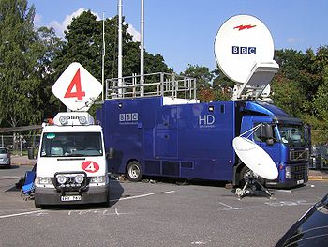
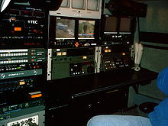
electronic news gathering means anything from a lone reporter taking a single camcorder out to get a story, to an entire television crew taking a satellite truck on location to do a live report for a newscast.

Slide 5
Contd…
Reporters on the ENG are equipped with live microwave and/or satellite trucks
Recorded graphics and sounds are transmitted to the studio
They are able to show live what is happening&
Bring the dramatic news events to the audience

Slide 6
Working of a camera
Lens system captures the image
Which is converted into electrical signal
Decoded and displayed as optical signal

Slide 7
CCD CAMERAS
CCD (Charged Couple Device) imager chip is a major technology for digital imaging.
CCDs are widely used in professional, medical, and scientific applications where high-quality image data are required.

Slide 8
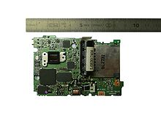
Early sensors were video camera tubes
a modern one is charge-coupled device (CCD)
or a complementary metal–oxide–semiconductor (CMOS)active-pixel sensor.

Slide 9
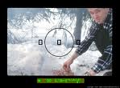
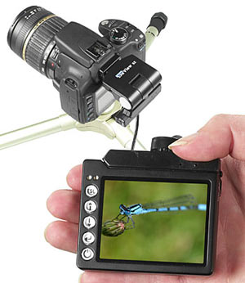
VIEWFINDER
A viewfinder is what the photographer looks through to compose, and in many cases to focus the picture
Viewfinders can be optical or electronic
EVF is a viewfinder where the image captured by the lens is projected electronically onto a miniature display.

Slide 10
CONTD…..
VIEWFINDER
Indicates deficiencies of camera shots
(light/ video strength/ reception/ qualities of Batteries )
Guides the cameraperson on the technical and aesthetic aspects
May not get details because the image is very small

Slide 11
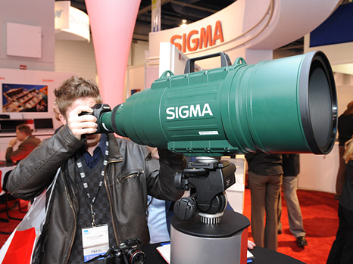
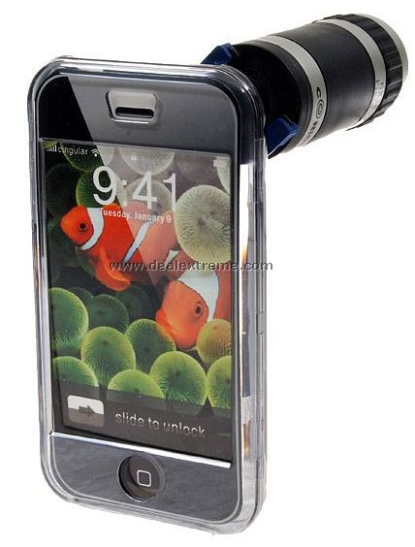
ZOOM LENS
Can be zoomed out to give wider coverage
Can be zoomed in to give narrower coverage
Brings the object closer and magnifies it

Slide 12
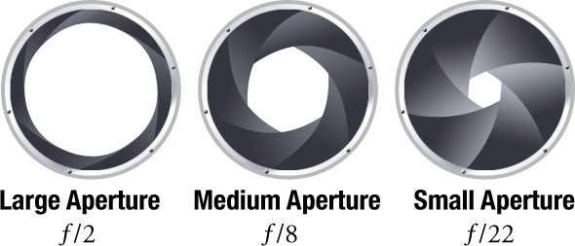
LENS APERTURE
Disc shaped focus control called the lens aperture or iris
It helps achieve finer/ sharper images
Iris diaphragm determines the brightness of the image

Slide 13
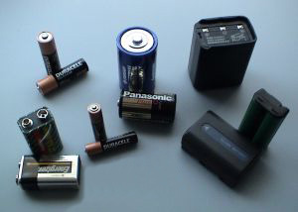
Battery requirements of a video camera
12- volt dc:
Which can be drawn from a car battery,
a portable VTR, internal battery, battery belt,
Shoulder pack, an AC power adapter to draw
from the mains in an indoor studio

Slide 14
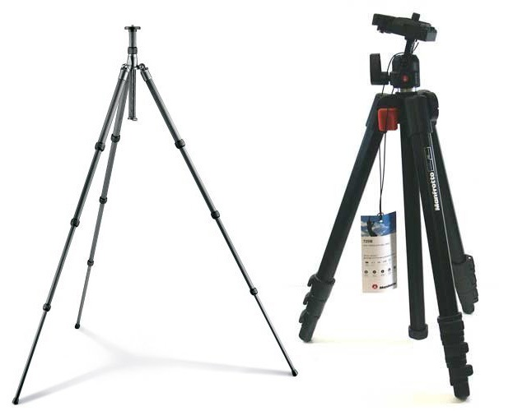
TRIPODS
Cameras mounted on the tripods can be moved left and right
The process is called trucked

Slide 15
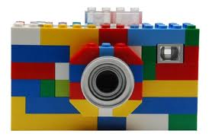
A cinematographer is an artist whose shots must be
aesthetically attractive
technically accurate &
appropriate within the context

