Slide 1
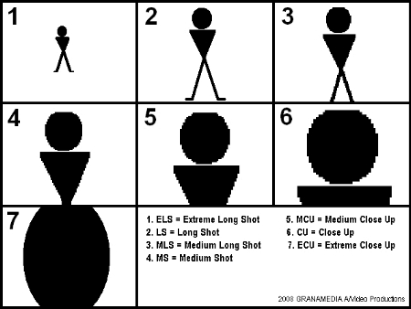
Varieties of shots
BY: JASREET KAUR
DEPT. OF ENGLISH

Slide 2
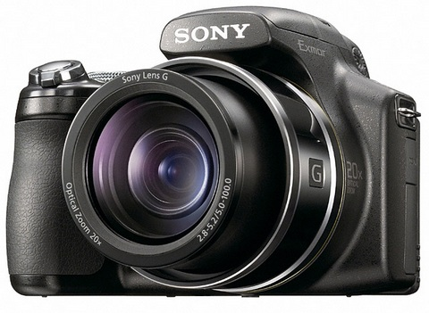

Slide 3

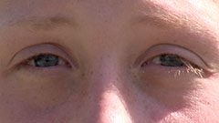
EXTREME CLOSE UP
Detail shot
Catches total attention
Magnified picture.

Slide 4
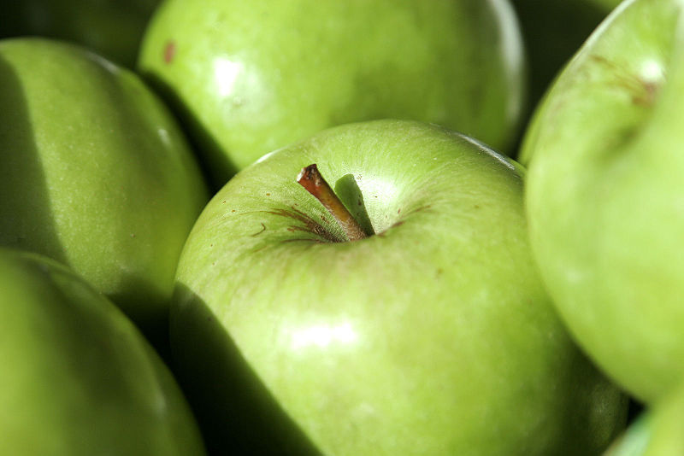
VERY CLOSE UP

Slide 5
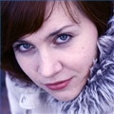
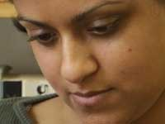
BIG CLOSE UP
Covers face & head all over the screen
also called tight close up

Slide 6
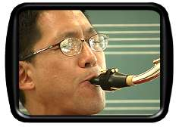
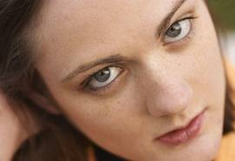
CLOSE UP
Face shot
Mid forehead to the chin

Slide 7
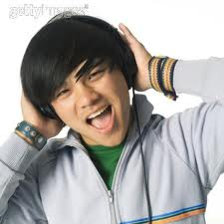
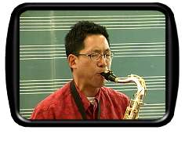
MEDIUM CLOSE UP
Shows subject from mid-chest area up.
Provides intimate view of subject, focuses attention on face.

Slide 8
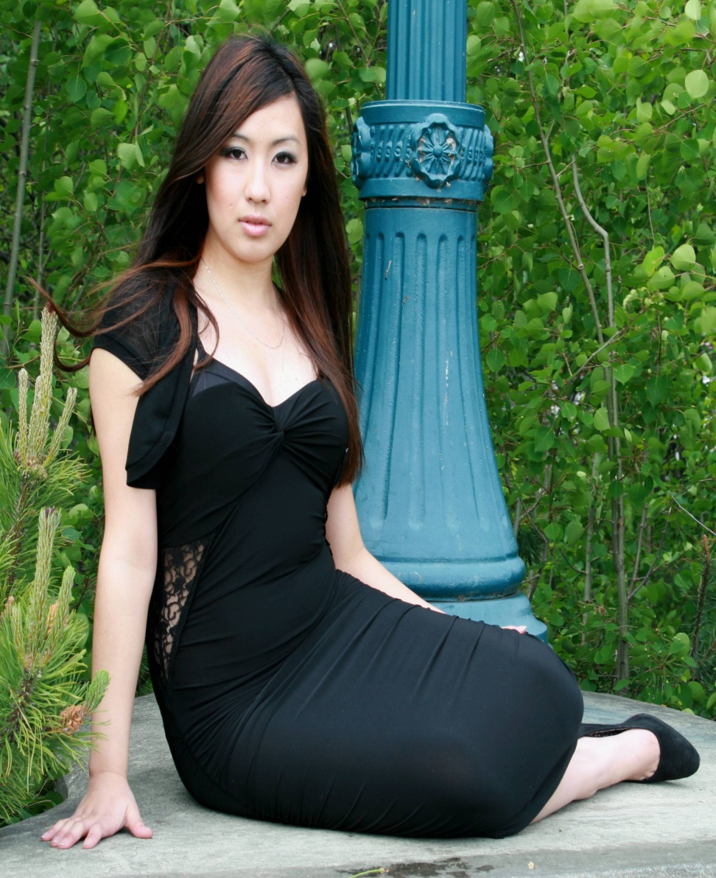
FULL LENGTH SHOT
Also called medium long shot
Covers the whole body &
Some of the surroundings

Slide 9
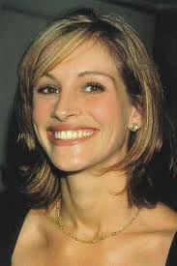
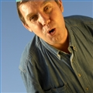
CLOSE MEDIUM SHOT
The frame captures the subject from the waist up.
This allows for a bit more detail to be shown in the frame.

Slide 10
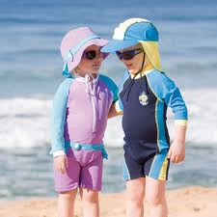
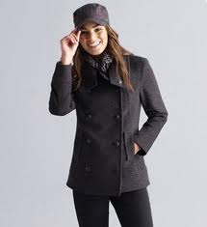
KNEE SHOT
Also called three fourth
Length shot
Covers the length from head to just below the knee

Slide 11
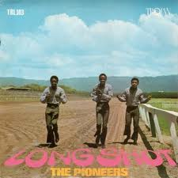
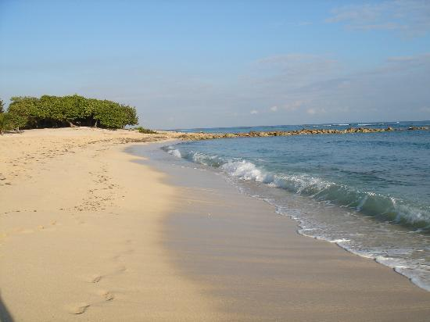
LONG SHOT
Occupies one third to three fourth of the screen

Slide 12
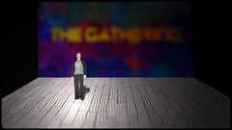
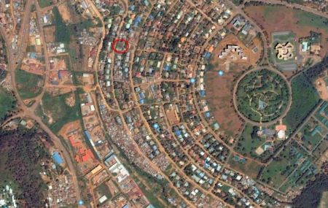
EXTRA LONG SHOT
The object appears very small compared to the surroundings

Slide 13
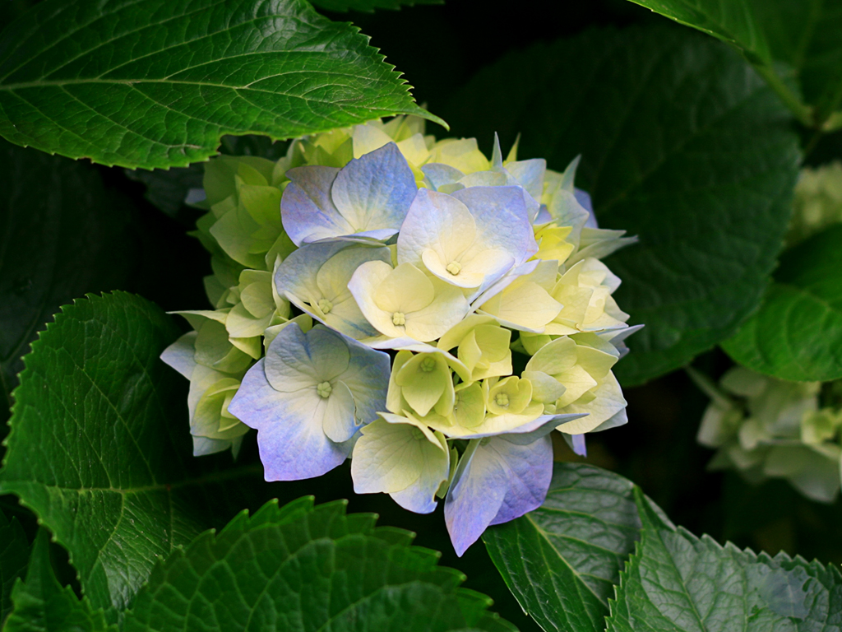
HAVE A NICE DAY

