Slide 1
T .V. STUDIOS
Size of the studio
Structure of walls
Cyclorama
Chroma key
Floor and ceiling

Slide 2
TV STUDIO
A medium sized studio measures:
Length: 55 feet
Width: 44 feet
Height: 40 feet

Slide 3
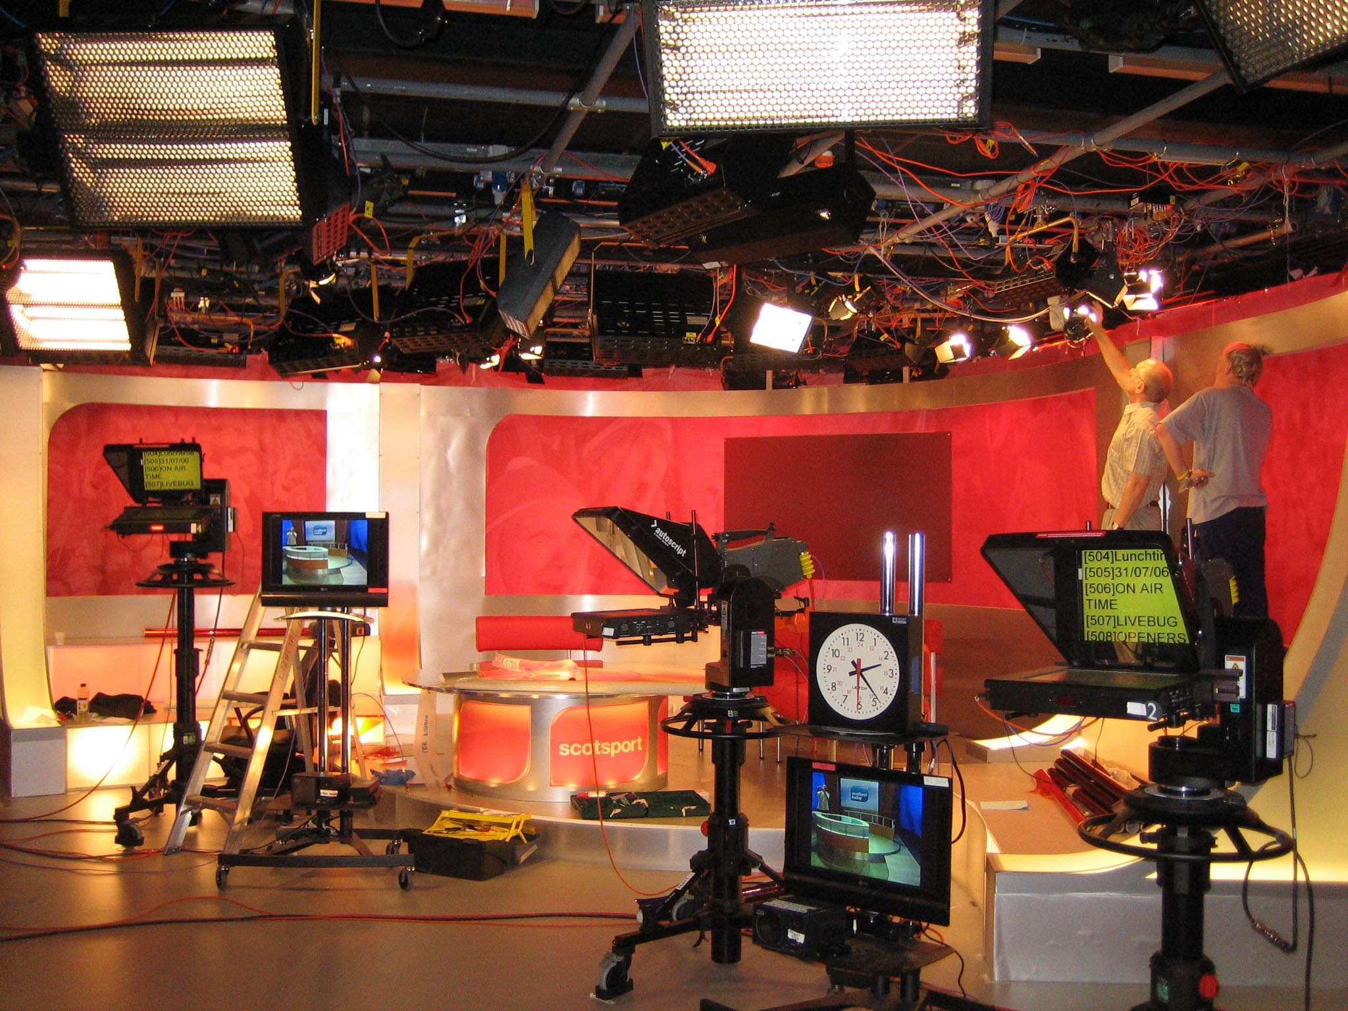

Slide 4
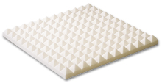
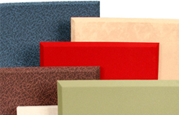
Acoustic sheets prevent sound reflection / echo
made up of 4 inch thick glass wool pads

Slide 5
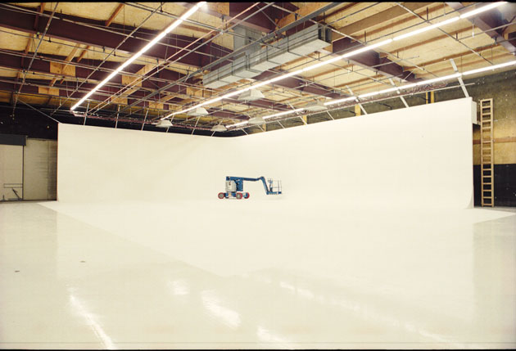
cyclorama
A rubber like perforated sheet
Covers / irregular wall surface
Gives plain/ uniform background
Wall seems invisible

Slide 6
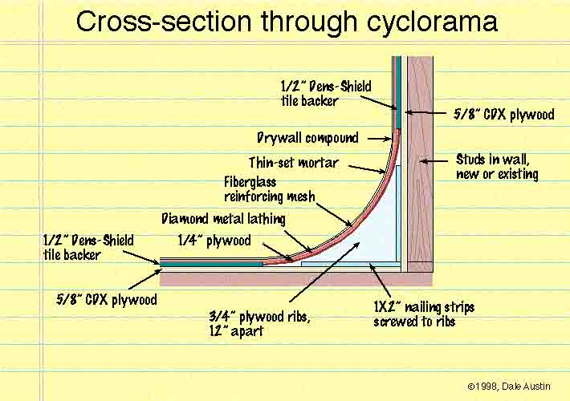

Slide 7
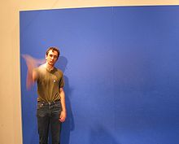
Chroma key
A technique by which a picture / film is projected on the screen behind a presenter.

Slide 8
contd……
Technique for compositing two images or frames together.
Also referred to as green screen, and blue screen.
Commonly used for weather forecast broadcasts, wherein the presenter appears to be standing in front of a large map, but in the studio it is actually a large blue or green background

Slide 9
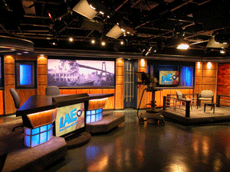
Floor & Ceiling
PVC flooring:
to minimize echoing
to avoid shock
for smooth movement of camera tripod stands
Ceiling :
Criss- cross iron frame
Space between filled with black iron sheets.

Slide 10
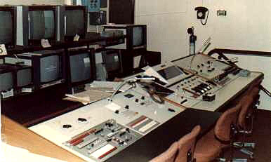
The editing room

