Slide 1

Money Management
Types Of Income, Budgeting,
Its Advantages And Disadvantages

Slide 2
Mo
Money is a medium of exchange. It has purchasing power. It can be used to buy goods and services required by an individual. It is a unit to measure the value of a commodity. Money is a yardstick to measure the standard of living of a family.
The amount of money a family receives in a specific period of time in the form of currency or services is called the income of family.
According to Nickel and Dorsey-Family income is that stream of goods , services and satisfactions that come under the control of the family, to be used by them to satisfy needs and desires and to discharge obligations.

Slide 3


Slide 4
Types of Money Income
Direct Income
Direct income is that income which is in the form of direct money. It can be in the form of salary or earned through business, rent from property, interest from banks.
Indirect Income
It is income that the family receives in the form services and facilities eg. free accommodation, free medical services, free transport and concession in rates of the items of daily use.

Slide 5
Classification according to some economists
Money Income
Consists Of Money Received In The Form Of Salaries, Wages, Pension. Rent e.t.c.
It is form of Income that can be used to buy goods
Real Income
Is the flow of commodities and services available for the satisfaction of human wants and needs over a given time e.g. free accomodation,free transportation etc
Psychic Income
Consists Of The Satisfaction Which a Person Derive From Real income or The Money
Psychic Income cannot be measured

Slide 6


Slide 7
Family Budget
A family budget is an estimated plan of future income and expenditure for a definite period i.e. a week , a month or an year to achieve maximum satisfaction from the earned money
Budget is account of income and expenditure, which saves money from wasteful expenditure.
Budget can be in written form or just mental plan

Slide 8


Slide 9
Types of Budget
Balanced Budget
Total income and the total expenditure are equal in this budget.
There is no money left for saving which makes it difficult to meet future goals
Surplus Budget
Income is more than expenditure and there is saving for family.
This budget is useful for achieving family goals.
Deficit Budget
Expenditure exceeds income then it becomes a deficit budget.
This budget is not good ,family should make effort to supplement family income by growing vegetables, stiching clothes for family members etc.

Slide 10
Factors Affecting Budget
Family income-Family has three types of income i.e. Money income, real income and psychic income. In poor families major part of the income is spent on basic needs 60% on food, while rich families spend 30% to 40%.
Expenditure-Understanding the different types of expenditure-
Fixed expenditure-Fixed amount of money to be spent every month eg house rent, electricity bill etc.

Slide 11
Semi-fixed expenditure-This type of income is necessary but dependent upon income, food and clothing etc
Other expenditure-This type of expenditure is never fixed. Due to lack of income recreational expenditures, luxury items can be cut down.
Size and composition of family-Depends upon number and age of family members. Small family will be able to spend more on needs as compared to large family. If children are small then more money allocated to food and care, if grown up then more money will be allocated to education. Age and sex of members also affects.

Slide 12
Stage of family life cycle-In an expanding family, expenses on baby foods care is quite high and income is less . As family expands needs increase, as children grow more expenditure on education then marriage then as family contracts expenditure decreases but medical bills increase. So budget plans keep changing due to changing demands.
Occupation of family members-The nature of job makes a diffrence, some jobs offer special benefits like fee concession , free medical service ,free accommodation.

Slide 13
Place of living-Expenses of families living in urban areas are more. Cost of living is more in cities ,money spent on housing, food , transportation etc.
Goals set by families-Families differ in values and accordingly goals. Some families give more importance to social status while others to education.
Socio -economic status of family-To maintain socio economic status families spend more on birthdays, picnics etc.
Skills and Abilities-An efficient home maker is a good buyer ,prepares many products at home thus reducing wasteful expenditure and help in saving for the family.

Slide 14
Planning Of Budget
Then main objective of a family budget is to plan allocation of money on various items of expenditure for meeting family needs. While preparing a budget the following points should be kept in mind-
1Enlist the items of expenditure-Goods and services should be listed on priority basis. Though these vary from family to family but basic needs and the expenditure on these items is more or less-
Food-Food is the most important item of the family budget, includes money spent on raw materials, like groceries vegetables etc, cooked and preserved foods, purchase and repair of cooking appliances ,wages of cook, cooking gas etc

Slide 15
Clothing-Includes buying of clothes for family, shoes, accessories, money spent on sewing, laundering, repairing etc
Housing-Includes charges on rented house or repair charges and annual maintenance ,taxes, property tax, furnishing costs, cleaning equipment, electricity bills, telephone bills etc.
Education-All expenses incurred in case of school or college education such as tuition fees costs of textbooks, stationary items, computers educational trips, hostel fees etc.

Slide 16
Transport-Includes expenditure incurred on use of public or personal transport system, cost of fuel, servicing, repair and maintenance of car or scooter ,road tax etc
Health care-Expenditures related to health and personal care of family members, medical consultation, hospital expenditure, medicines etc
Entertainment-Expenditure on recreation depends on economic status of family, age, sex and education. It includes TV. radio, going to hill stations, picnics etc
Savings-There should be saving in the family for unforeseen expenditure and emergencies eg. higher education, marriage sickness etc

Slide 17
2.Estimate the cost of the desired items-Before estimating the cost the expenditure can be divided into three categories i.e. Fixed expenditure, semi fixed and other expenditures. Check the market rate from time to time.
3.Estimate the total income-Family income not only include money income but also real income. Income can also be divided into assured and possible income. One should meet essential needs from assured income and possible income for luxuries and other unnecessary items.

Slide 18
4. Allocation of some money for saving-After allocating money for fixed expenditure some money should be kept for saving in the form of saving schemes then money should be allocated for other expenditures.
5.Bringing in balance expected expenditure and the expected income left after saving. It should be a surplus budget.
6.To evaluate the budget plan-
a. Is the plan realistic?
b. Can it satisfy all the wants of the family?
c. Have all expenditures be given due attention?
d. Is it possible to make a change in the budget due to fluctuation in prices or is the budget flexible or practical in other words.

Slide 19
Allocation of money for different items
According to ‘Érnst Engel’ the economist-
As the income increases, the percentage of the income spent on food decreases though the total money spent on food increases.
As the income increases, the percentage of the income spend on housing , clothing and lighting remains unchanged.
As the income increases the percentage of income spent on education and health increases.

Slide 20
Percentage Of Income -Different Items For Families –Different Income Group
Item | Percentage Expenditure
 | Low Income | Middle Income | High Income
Food | 60% | 55% | 50%
Clothing | 18% | 18% | 18%
Housing | 12% | 12% | 12%
Lighting | 5% | 5% | 5%
Education And Health | 5% | 5% | 5%

Slide 21
Budget Estimates For Different Income Groups
 | Low Income Rs.6000 |  | Middle Income Group |  | High Income Group
Item | Rs. spent | %age | Rs. spent | %age | Rs. spent | %age
Food | 3000 | 50 | 8750 | 35 | 16200 | 27
Clothing | 600 | 10 | 2000 | 8 | 6000 | 10
Housing | 1500 | 25 | 6250 | 25 | 15000 | 25
Education | 120 | 2 | 1500 | 6 | 4200 | 7
Health | 180 | 3 | 1000 | 4 | 3000 | 5
Tranportation | 180 | 3 | 1250 | 5 | 3000 | 5
Recreation | 120 | 2 | 1250 | 5 | 2400 | 4
Miscellaneous | 120 | 2 | 1250 | 5 | 4200 | 5
Saving | 180 | 3 | 1750 | 7 | 6000 | 10

Slide 22
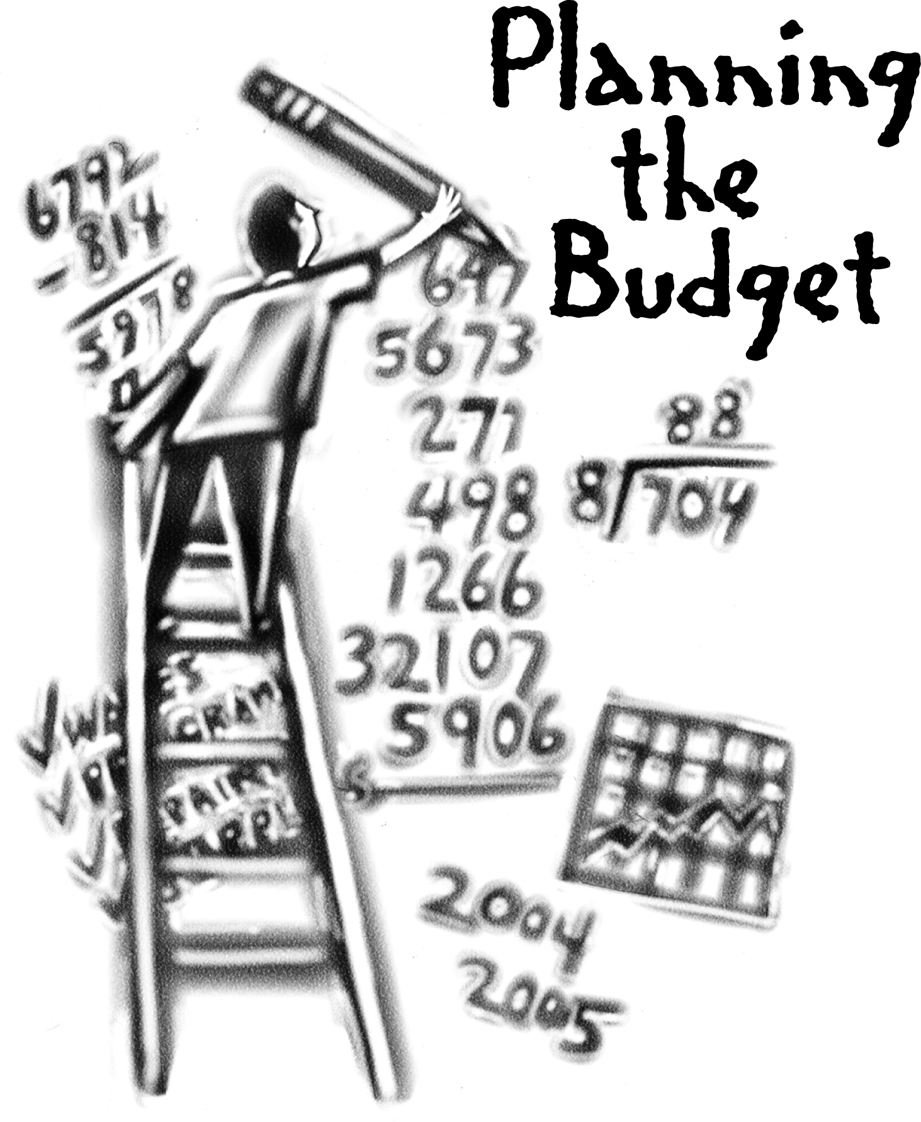
Drawbacks Of Engel’ Law
Engel ‘ law holds true to certain limits but with the passage of time this needs improvement due to modernization and change in family needs.
The budget plan has no place for savings.

Slide 23
Advantages Of Budgeting
1.Financial Guide
2.Careful expenditure
3.Proper Allocation.
4.Motivation to live within one’s resources
5.Checks on wasteful expenditure
6.Savings
7.Proper balance in budget
8.Time record
9.Law of equal marginal utility
10.Helps in attaining family goals

Slide 24
Disadvantages Of Budget
Though can help to make best use of money but it cannot increase money
Budget is just an estimate not the real plan
Budget becomes ineffective when prices fall
Budget cannot give the person the ability to select products in the markets

Slide 25

Means Of Supplementing
Family Income
By supplementing the income
By spending money judiciously

Slide 26
By supplementing family income
By establishing small scale industries-Along with regular job some small scale industry can be started at home like poultry farming, bee keeping, knitting, stitching, embroidery, making papad etc
By utilizing time properly- by using labour saving devices and combining two jobs like cooking and ironing some time can be saved which can be utilized for other income raising activities. She can utilise her skills for production of goods ,start tuition classes or creche, beauty parlour etc

Slide 27
By preserving the food in season-
By proper use of waste material-
Careful Expenditure of money-
Reinvestment of savings- in saving schemes, business ,buying property etc
By getting maximum benefit from community facilities
Thus a careful expenditure of money and curtailing down of wasteful expenditure in addition to an effort made by family to increase family income can help improve economic status of family

