Slide 1
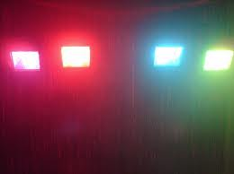

B.A.II functional
English
Kinds of studio lights
&
audio system
Prepared By:
Jasreet kaur
Dept of English
August, 2010

Slide 2
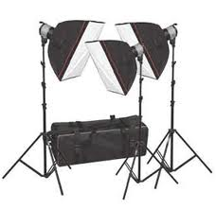
Studio Lights
Quartz or tungsten- halogen lights in orange yellow colour are used in most of the studios

Slide 3
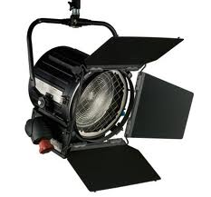
Fresnel spotlight
Cylindrical in shape
300 & 200 watts
Four metallic flaps (barn doors) to adjust the quality and direction of the light
Wide beam removes most of the shadows
A studio has 60 of them

Slide 4
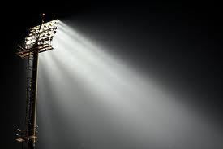
Flood lights / fill lights
Spread diffused light
Helps remove shadows created by spotlights
30 of them are used in a studio

Slide 5
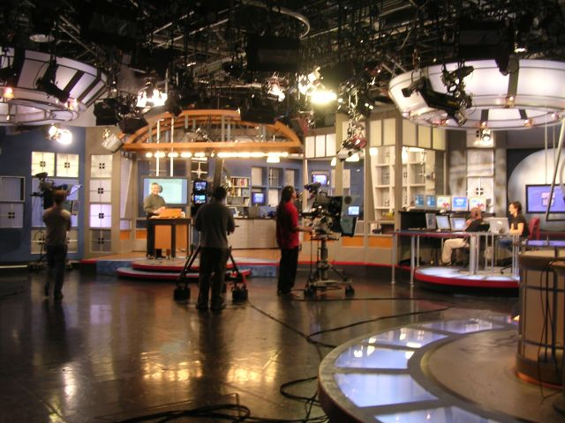
Base lights & Back light
Overall lighting of the stage
Back light produces three dimensional effects

Slide 6

Eye light
Focuses on the performer’s face
Floor lights are used to light up low areas

Slide 7
Studio lights…
Studio lights, controlled by the hoist control board, are suspended from hoists attached to the iron frame
Lighting control room monitors the lighting of the studio
Electronic dimmer panel controls maximum of 30 lights
Communication between the LCR and the studio takes place through the talk back unit

Slide 8

Audio System
What camera is to visuals, the microphone is to sound

Slide 9

Microphone
Consists of diaphragm &
Generating element which converts sound waves into electrical impulses

Slide 10
Classification of mikes
On the basis of:
Techniques by which they are mounted
Directions from which they pick up sounds
Range of frequencies

Slide 11
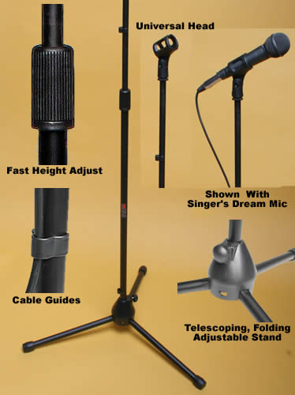
Floor stand mike / table stand mike
Used in educational institutions

Slide 12
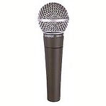
Stick mike / hand mike
Used by the stage singers &
Interviewers on vox populi shows

Slide 13
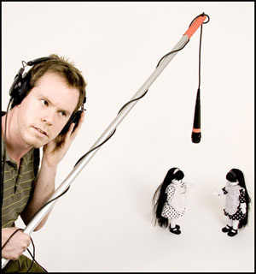
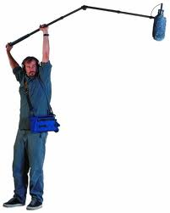
Pole mike / boom mike
Boom mike can be lowered, extended and rotated

Slide 14
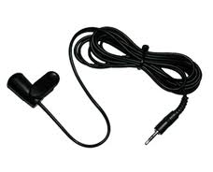
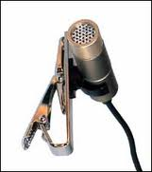
Clip- on mike / tie- tack mike
Allows freedom of movement and keep the hands free

Slide 15
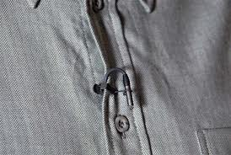
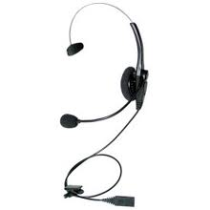
Electret mike
Plays the invisible role

Slide 16
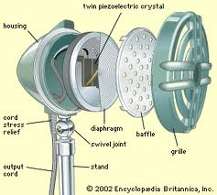
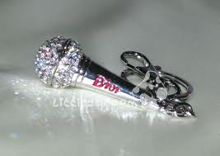
Crystal mike

Slide 17
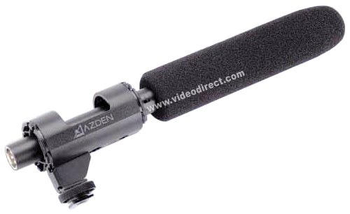
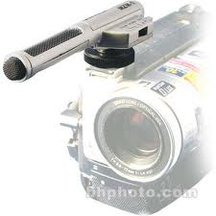
Camera mikes
Insert mikes/ zoom mike / rifle mike

Slide 18
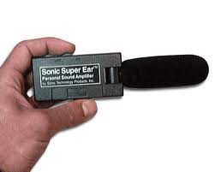
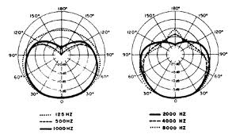
Classification on the basis of direction
Directional mike/ Omni directional

Slide 19
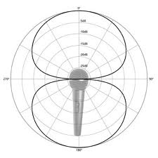
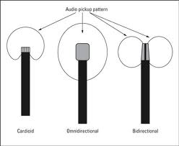
Bi directional mike
Dead at the sides
Live in the front and rear drawing a ‘figure of eight’

Slide 20
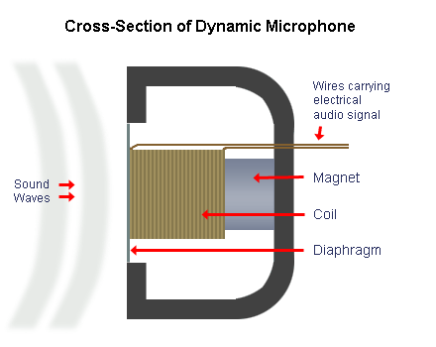

Classification based on Frequency
Dynamic microphone

Slide 21
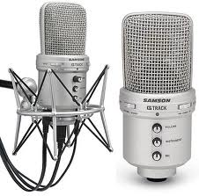
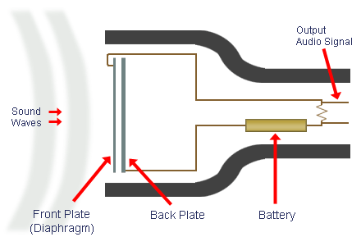
Condenser microphone
More sensitive than dynamic mics
Have additional battery power source

