Slide 1

Essential Food Constituents
Vitamins

Slide 2
Vitamins are organic substances which are present in foods in small amounts and are required by the body in small amounts but are essential for good health, growth and maintenance of the body processes.
Two types of vitamins-
Fat soluble
Water soluble
Fat soluble vitamins-Vitamin A
Vitamin D
Vitamin E
Vitamin K

Slide 3
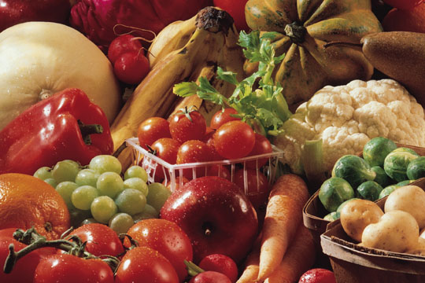
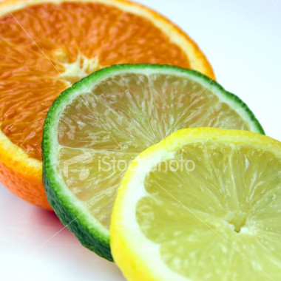
Vitamin B Complex-
Vitamin B1 Thiamin
Vitamin B2 Riboflavin
Vitamin B6 Pyridoxine
Vitamin B12
Niacin
Pentothenic acid
Folic acid
Vitamin C

Slide 4
Fat Soluble Vitamins
Soluble in fat and fat solvents but insoluble in water.
Excess amount gets absorbed in body.
Excess amount may prove harmful to body.
Dietary inadequacies-symptoms do not appear soon as body stores present
Stable to ordinary cooking methods.
Water Soluble Vitamins
Insoluble in fat and fat solvents but soluble in water.
Excess excreted through urine
Excessive intakes not harmful.
Dietary inadequacies-deficiencies symptoms-soon as no body store
Sensitive to light, heat etc -destroyed by ordinary cooking methods

Slide 5
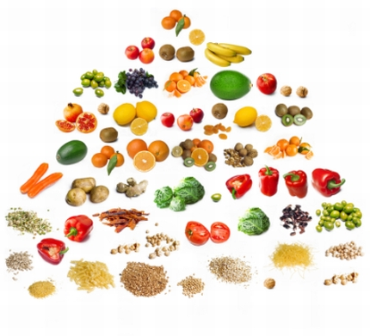
Importance of Vitamins
For growth and development
To carry out various body processes
To fight infectious diseases
For mental equilibrium

Slide 6
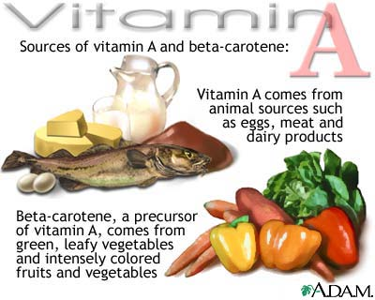
Vitamin A

Slide 7
_P

Slide 8
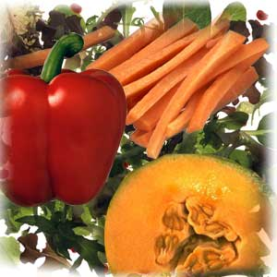
Vitamin A is a pale yellow coloured compound made of carbon , hydrogen and oxygen. Chemical name is retinol. Soluble in fat but insoluble in water-stable to heat.
Carotene is a precursor of vitamin A. It is deep red in color-plant source of vitamin A. Body has ability to convert carotene to vitamin A.

Slide 9
Food Sources Of Vitamin A
Sources of vitamin A-
Animal sources-fish liver oils such as cod liver oil –richest source, butter, ghee, milk, egg yolk and liver.
Vegetable source-Carotene-present in plants which are green or yellow in color eg. pumpkin, carrots, tomatoes, capsicum, green leaves and yellow fruits such as mango, papaya etc

Slide 10
Functions Of Vitamin A
For growth of body-essential for normal skeletal growth and tooth development.
For health of epithelial cells of body.
For synthesis and functioning of visual pigments-maintenance of proper vision in dim light. Retina of eye contains-rods and cones .Rods are functional for vision in dim light and cones in bright light.When bright light strikes these pigments rhodopsin present in rods breaks down into retinene and protein with some loss of vitamin A.If sufficient amount of vitamin is not available rhodopsin is not synthesised-eyes take long time to adjust- not able to see in dim light-night blindness

Slide 11
For reproduction-important for formation of sperms in males and normal reproductive cycle in females.
For protection against infections-provides resistance against infections of respiratory tract.
Recommended Allowances-depends upon age and physiological state.Adult man 600 microgram of vitamin A or 2400 microgram of beta carotene, in lactating mothers it can go up to 950 microgram or 3800 microgram.

Slide 12
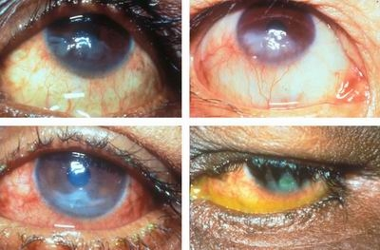
Effects Of Vitamin A Deficiency
Night blindness
Eye infections-
(a) Xeropthalmia
(b)Bitot spots
(c)Keratomalacia
Epithelial changes
Follicular keratosis
Low resistance to infections
Retardation of growth
Reproductive disorders
Prone to formation of kidney stones

Slide 13
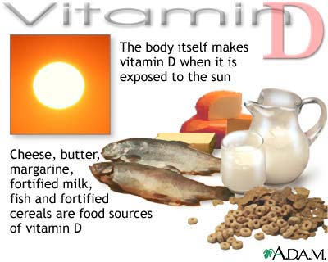
Vitamin D

Slide 14
The chemical name for vitamin D is calciferol. Also known as anti rachitic vitamin. Sterols a class of fats ,are the precursors of vitamin D. Two important sterols ere 7 dehydro cholesterol and ergosterol
Food sources –Richest source is fish liver oil, butter ,milk and egg yolk.
Ultra violet rays in the sun synthesize vitamin D in our body.7dehydrocholesterol present beneath the skin is converted to vitamin Din the presence of sunlight-also known as Sunshine vitamin.

Slide 15
Functions Of Vitamin D
For the formation of bones-regulates the amount of calcium and phosphorus in the body.
For the absorption of calcium and phosphorus from intestines-Promotes rate of absorption of ca and phos and regulates calcification of bones and teeth.
For growth-Essential for bone formation-considered important for growth.

Slide 16
Recommended allowances-No allowances have been recommended by ICMR 1990.Direct exposure to sunlight for 5 minutes is sufficient.
Deficiency of vitamin D-
Rickets-found in children living in dark places due to deficiency of calcium and vitamin D
Tetany-results in disturbance in calcium and phosphorus metabolism. Excitability of nerves increase due to low blood calcium levels and muscle contracts involuntarily.

Slide 17
Deficiency of vitamin D (contd )
Dental caries-Teething is delayed in infants and malformation of teeth.
Osteomalacia-also known as adult rickets. Means softening of bones. During pregnancy and lactation requirement increases as a result ca and phosphorus metabolism is disturbed.
Osteoporosis-results in deficiency in old people generally in women after menopause.

Slide 18
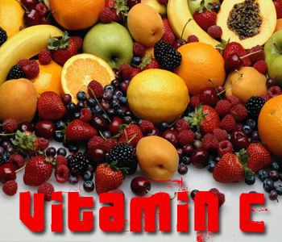
Vitamin C

Slide 19
Chemical name for is vitamin C ascorbic acid.It is water soluble and destroyed by oxidation.
Food Sources-fresh fruits and vegetables are main source. Amla –richest source. Guava, green leafy vegetables and citrus fruits are good sources. Eggs ,milk, cereals and pulses do not have vitamin C. Sprouting of pulses – makes them a fair source of vitamin C.
Recommended Allowances-Acc. To ICMR-25mg per day for infants up to 1 yr of age and 40 mg for children and adults, increases to 80 mg during lactation.

Slide 20
Functions of vitamin C
1. For formation of collagen-a cementing material that holds cells together.Collagen is a protein important for wound healing,strengthing of teeth etc.
2. For cell respiration-participates in iron metabolism-transportation of oxygen to cells.
3. For prevention of against infectious diseases-helps in building immunity against infectious diseases.

Slide 21
Functions of vitamin C (contd)
4.For functioning of enzymes-
Ascorbic acid enhances iron absorption by converting ferric to ferrous form.
Releases iron from transferrin
Converts folic acid into active form-
Conversion of cholesterol to bile acids
Converts amino acid to tyrosine
5 . For functioning of adrenal glands
6 . As an anti oxidant

Slide 22
Effects of Deficiency of vitamin C
Pain in joints
Irritability
Retardation of growth in children
Anaemia
Shortness of breath
Delayed wound healing
Low resistance to infections

Slide 23
Scurvy
Infantile scurvy- infants up to 1 year of age. Cause- weaning of mother’s milk Symptoms-
Child becomes weak
Fever ,diarrhoea and vomitings.
Gums tender, swollen and bleeding.
Skeletal deformities.
End of long bones-enlarged.
Anaemia is present.

Slide 24
Adult scurvy
Follicular keratosis-horny growth of dead cells in the hair follicle.
Gingivitis-gums swollen ,tender and red.
Muscles in legs weak and tender
Folic acid not converted into folinic acid
Excessive bleeding and internal haemorrhage beneath skin
Swelling and pain in joints
Loss of weight
Healing of wounds take long time

Slide 25
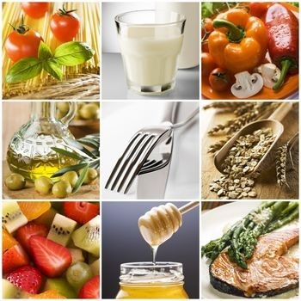
Vitamin B complex

Slide 26
Water soluble B complex is a group of compounds which are essential for well-being of each cell. Essential for normal metabolism of food. All vitamins in the group are related to each other and to production of energy. Important vitamins-
Thiamin
Riboflavin
Niacin
Pyridoxine
Folic acid
Cynocobalamine

Slide 27
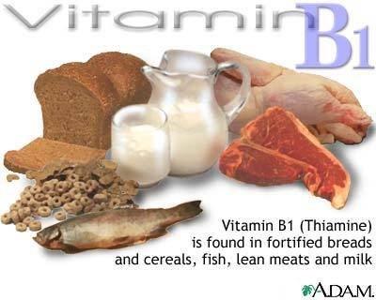
Thiamine or Vitamin B1
It is a crystalline white powder made of carbon, hydrogen, nitrogen, sulfur and chlorine. Stable in dry form but being water soluble it is destroyed during cooking.

Slide 28
Food Sources-All foods except fats ,oils and pure sugar provide some amount of thiamine. Brewers yeast ,wheat germ and bran of cereals are excellent source. Whole grain cereals and pulses and nuts –good source.
Recommended Source-As thiamine is associated with energy metabolism so daily requirement depends on calorie intake of the individual. Daily requirement of thiamine increases if calorie intake increases and decreases with decrease in calorie intake.

Slide 29
Functions of Thiamine
Thiamine pyrophosphate functions as a co- enzyme for release of energy metabolism. During deficiency lactic acid and pyruvic acid gets accumulated in the blood.-causes fatigue and loss of appetite Important role in oxidation processes of body cells.
Necessary for growth- promotes good appetite and better functioning of digestive tract.
In the enzyme system-
Thiamine pyrophosphate together withvitamin B complex works for utilization and storage of energy.

Slide 30
Functions of Thiamine (contd)
Role in heart functioning-Deficiency impairs functions of heart-collection of extra vascular fluid and results in cardiar standstill.
For mental health-also known as Morale Vitamin bacause of its role in maintaining healthy mental attitude.

Slide 31
Deficiency of Thiamine Beri-beri
Early symptoms of deficiency are-
Fatigue
Lack of interest in routine activities
Emotional instability
Irritability
Loss of appetite
Indigestion
Constipation
Headache
Lack of sleep
Increased heart beat
Heaviness and weakness in legs
Morale low and memory impaired

Slide 32
Beri beri(contd)
Beri beri is of two types-
Infantile beri beri found in infants of 1-4 months of age due to lack of thiamine in mother’s diet . Symptoms-
Paleness
Oedema
Irritability
Vomiting
Abdominal Pain
Loss of voice
Convulsions
Infant can die within few hours but recovery is fast

Slide 33
Adult beri beri is of two types-
Dry Beriberi-Is a condition in which no oedema but emaciation of muscles
Wet Beriberi;there is odema and body cells swell due to retention of fluid.
Symptoms of dry beriberi-
Multiple neurotic syndrome
Muscles wasted
Difficulty in walking
If not treated patient dies

Slide 34
Wet beriberi-
Odema
Palpitation and breathlessness
Calf muscles –tense, swollen and tender
Diastolic blood pressure low and systolic blood pressure high
Pulse fast and bouncy
Heart weak
Person feels weak and easily exhausted
Death occurs due to heart falure

Slide 35
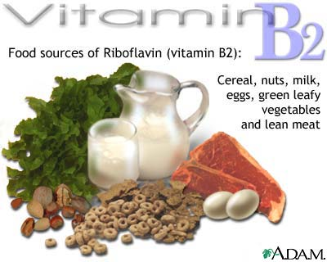

Slide 36
Vitamin B2 is a yellow colored compound ,soluble in water stable to heat but destroyed by alkalies and oxidation.
Food Sources-Brewer’s yeast is richest source. Animal foods, milk and milk products, eggs, green leafy vegetables and liver are other rich sources. Wheat ,millet and pulses are good sources.

Slide 37
Functions Of Vitamin B2
As a co-enzyme in energy metabolism-Riboflavin phosphate and Flavin adenine dineucleotide required in Krebs’s cycle
For oxidation of proteins-
For healthy eyes and skin.
For tissue respiration.

Slide 38
Deficiency Of Riboflavin
Ariboflavinosis generally combined with deficiency of other vitamins of B complex.
Common Symptoms-
Angular of lips –red and rough
Glossitis-Ulceration of tongue. stomatitis-Cracking of skin of lips at corners of mouth.
Cheilosis-Mucous membrane

Slide 39
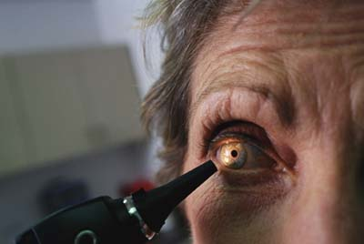
Seborrhoea-The sebacious glands in skin become dry and wrinkled.
Conjuctivitis-Watering in the eyes vision blurred
Vascularization of cornea-Eyes red due to appearance of red blood capillaries.

Slide 40
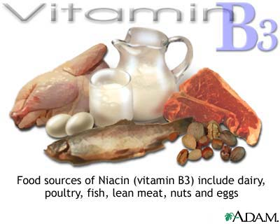
C:\Documents and Settings\Administrator.ADMIN-8D457764A\Desktop\vitamin-b3-source.jpg

Slide 41
Chemical name for niacin is nicotinic acid. It is soluble in hot water ,stable to heat, acids, alkalies and light.
Food Sources-Protein rich foods because tryptophan –amino acid has the ability to be converted to niacin in the ratio of 60:1 in human beings, vitamin B 6 is required.
Best source-brewer’s yeast, chicken, fish, meat etc. Whole grain cereals and pulses are good sources and sprouting and fermentation increases niacin content by 50%.

Slide 42
Functions of Niacin
For energy metabolism-Constituent of many coenzymes involved in metabolism of fats ,carbohydrates and protein.NAD-nicotinamide adenine dinucleotide and NADP nicotinamide adenine dinucleotide phosphate carry out important energy releasing reactions in krebs cycle.
For normal functioning of skin, intestinal tract and nervous system.

Slide 43
Recommended allowances
As other vitamins of B complex group allowances are associated with calories. Increases with increase in calories.ICMR has recommended 6.6mg/1000 calories

Slide 44
Effects Of Deficiency Of Niacin
Pellagra is caused by niacin deficiency in areas where corn is staple diet.
Also known as disease of 4 D’s.Symptoms
Dermatitis-Itching and burning sensation in skin if not treated becomes ulcerated.
Diarrhoea-Mucous membrane of digestive gets affected and diarrhoea occurs.
Dementia-Dizziness, irritability, loss of memory, confusion and neurological disturbances.
Death-If not treated then death occurs.

Slide 45
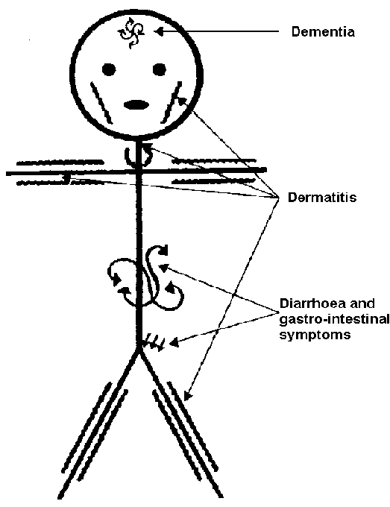

Slide 46
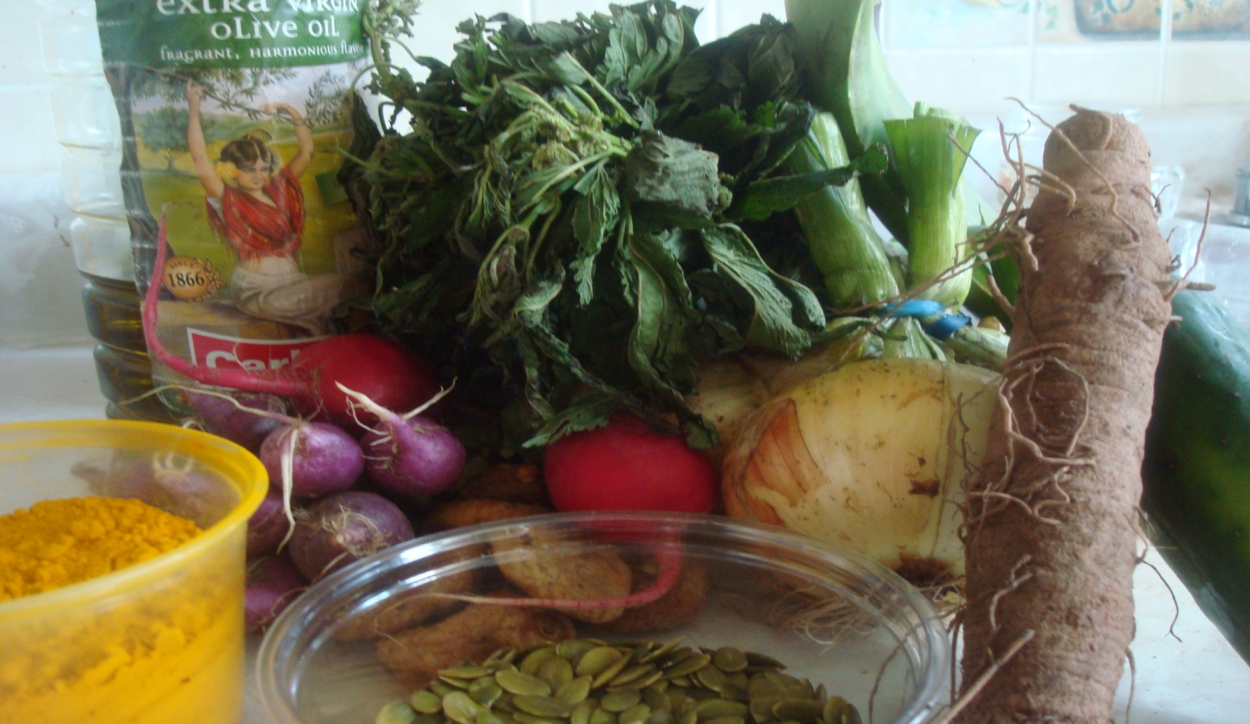
Minerals

Slide 47
Minerals make up 4% of total body weight.
Minerals are those organic compounds that remain in the form of ash after combustion of organic matter in plants and animals.
Major elements-calcium, phosphorus, potassium, chlorine, sodium are needed in large amounts
Minor elements in small amounts and trace elements in very small amounts eg. iron, cobalt, manganese, iodine and zinc.

Slide 48
Functions Of Minerals
Body building functions:
As building constituents in hard tissues such as formation of bones and teeth.
As components of soft tissues eg. Phosphorus in muscles and nervous tissues.
In compounds essential for functioning of body eg. Iron in haemoglobin, zinc in insulin hormone, and iodine in thyroxin hormone.

Slide 49
Regulatory Functions
Contribute to maintain osmotic pressure of body fluids and help in removal of waste products from cells
Maintain neutrality of blood maintains blood ph to 7.4
Helps to maintain a normal response of nerves to stimuli
Makes possible normal rhythm in heart beat
Helps in blood clotting
Helps in movement of nutrients in body fluids eg.phospholipids for transport of fat

Slide 50
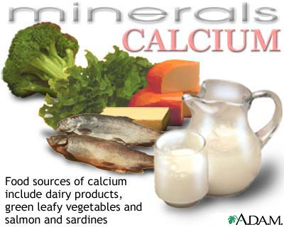
Calcium

Slide 51
Food Sources of calcium
Animal Sources:
Milk is best source,100gm of milk provides 200mg of calcium
Milk products such as curds ,cheese are good sources
Meat is not good source but small fish and sea food good sources

Slide 52
Vegetable Source:
Except spinach, leafy vegetables such as amaranthus,mustard sag,turnip leaves and fenugreek leaves-good source
Pulses, nuts,dry fruitssuch as apricots,kishmish,datesetc –provide significant amounts
Cereals –less amount of calcium and presence of phytic acid.Ragi –cereal –good source

Slide 53
Functions of Calcium
Building of bones and teeth: Calcium together with other minerals give rigidity and permanence to bones and teeth.Chief minerals in bone are calcium and phosphorus in the ratio2:1.Formation of bone- organic framework is formed by collagen protein, some mucoproteins and mucopolysacharides.Calcium and phosphorus form crystals of calcium phosphate which get deposited in this framework.The process of gradual deposition of minerals for hardness of bones –Ossification or mineralisation.

Slide 54
Regulation of some body process:
Calcium increases the permeability of cell membrane-helps in absorptive processes
Activates a number of enzymes such as lipases and proteolytic enzymes
Contraction of heart muscles
Calcium-essential for clotting of blood
Prothombin +Calcium---------------Thrombin
( Inactive) Thromboplastin (Active)
Fibrinogen ----------------------- Fibrin
(soluble protein) Thrombin (insoluble protein) Clot
Helps absorbs B12 in the illeum
Ionic calcium effects neuromuscular ability of voluntary and involuntary muscles

Slide 55
Factors enhancing absorption of calcium
Vitamin D
Protein
Ascobic acid
Hydrochloric acid in stomach
Lactose
Ratio of calcium to phosphorus
Physiological need

Slide 56
Factors interfering with calcium absorption
Oxalic acid
Phytic acid
Cellulose
Fat

Slide 57
Effects of Calcium Deficiency
Lack of calcium rich foods, poor digestion and absorption
or utilization of calcium leads to deficiency:
1.During pregnancy calcium needs increase due to growing foetus,to maintain blood calcium levels during deficiency the calcium present in mother’ s bones starts to dissolve esp. back bone, pelvic bone and bones of legs.This condition is known as ostomalacia.Quality and not quantity of bone is reduced.It also affects the foetus.
2.During growth period- deficiency results in deformities in
bones and teeth in children.Body growth is retarded,
bones become become soft and break easily.This
condition is known as rickets

Slide 58
Symptoms of rickets:
Epiphyseal enlargement: Enlargement of ends of long bones.
Beaded chest: Rounded projections on the ribs. Easily detected by running finger over rib ,beaded or rosary effect.
Knocked knees
Hypotonia: muscles become weak.
Skull becomes soft and bulges out.
Delayed teething
Child becomes restless and irritable

Slide 59
During old age: Deficiency leads to osteoporosis-bone mass of skeleton decreases,decalcification of bone starts.
Tetany:Charaterized by low serum level as a result excitability of nerves increases and there is in voluntary contraction of muscles
Interference in body regulation:
Blood clotting takes longer time
Contraction of heart muscles-irregular
Permeability of cell wall decreases

Slide 60
Recommended allowances

Slide 61
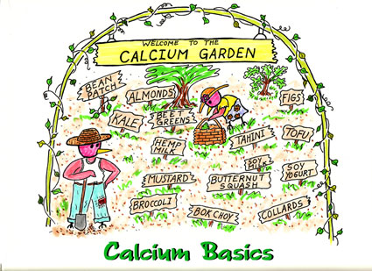

Slide 62
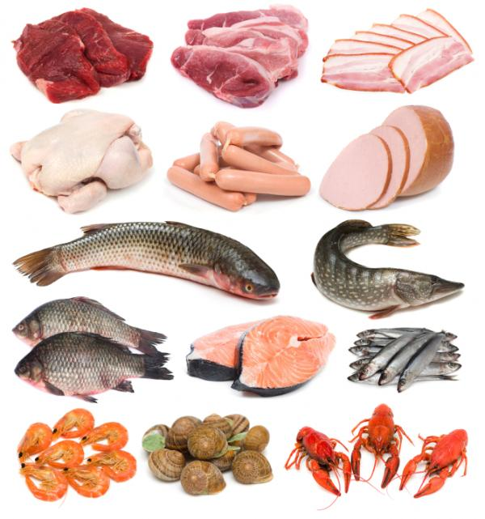
Phosphorus

Slide 63
Phosphorus accounts for about 1% of the total body weight.In bones the ratio of calcium to phosphorus is 2:1 but in soft tissues higher amounts of phosphorus than
calcium
Functions Of Phosphorus-
1For the formation of bones:Phosphorus combines with calcium to form calcium phosphate.Gives strength and rigidity to bones.
For maintenance of skeleton-Phosphorus keeps interchanging with blood phosphorus, thus helps in maintaining the skeleton

Slide 64
3.For metabolic processes-plays a significant role in metabolic processes of cells.-phosphorylation-key reaction for absorption of glucose.
4.In the form of phospholipids-combine with lipids to form phospholipids-regulate transport of soluble materials in and out of cells.Lipoproteins help transport of in circulation
5.In the formation of DNA and RNA –control hereditary

Slide 65
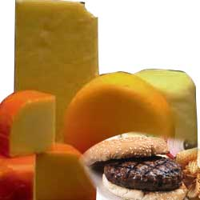
6.For storage and controlling the release of energy.Phosphorus compounds such as ADP and ATP(Adenosine diphosphate and Adenosine triphosphate )
7.For maintaining the neutrality: inorganic phosphates in the body fluids constitute an important buffer system.

Slide 66
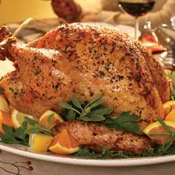
Food Sources OF Phosphorus
Important Sources-meat, fish, eggs and all dairy products also provide protein and calcium.Whole wheat flour contains more phosphorus than refined flour.

Slide 67
Recommended Dietary Allowances
Indian diets provide sufficient amounts of phosphorus and deficiency rarely occurs.ICMR has recommended to maintain a calcium phosphorus ratio 1:1 for all age groups except infants 1:1.5
Deficiency of phosphorus is very rare because insdequecy rarely occurs in humans.

Slide 68
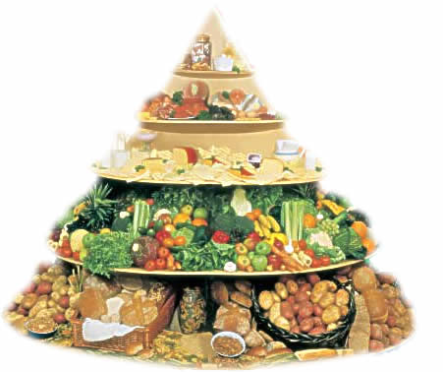
Iron

Slide 69
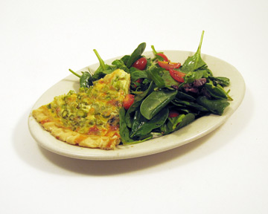
Iron is of great importance because of its role in the oxidative process in our body.It is essential for the transport of oxygen to cells and removal of carbon dioxide from the cells. 70 to 80% of iron is functional-circulating iron-transferrin and the remaining is present in stored form as ferritin in liver, spleen and bone marrow.

Slide 70
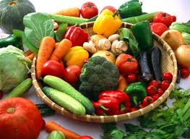
Functions of Iron
For the synthesis of haemoglobin in red cells- Haemoglobin is chief component of red cells,made up iron containing pigment heme ,and protein -globin.It acts as a carrier of oxygen from lungs to tissues the form of oxy- haemoglobin and carries back deoxygenated blood back from tissues to lungs for release of carbon dioxide and oxygen is picked up .

Slide 71
In the blood plasma-only a small amount of iron in blood plasma-0.2% it is circulated and used for transport-transferin
The level of iron in plasma is indicator of state of iron metabolism in the body.
In muscle tissue-In two forms-
1 As myoglobin-It is a carrier of oxygen to tissues used in muscle contraction
2 As a constituent of certain enzymes-makes oxidation of carbohydrates fats and protein possible within intact cell.

Slide 72

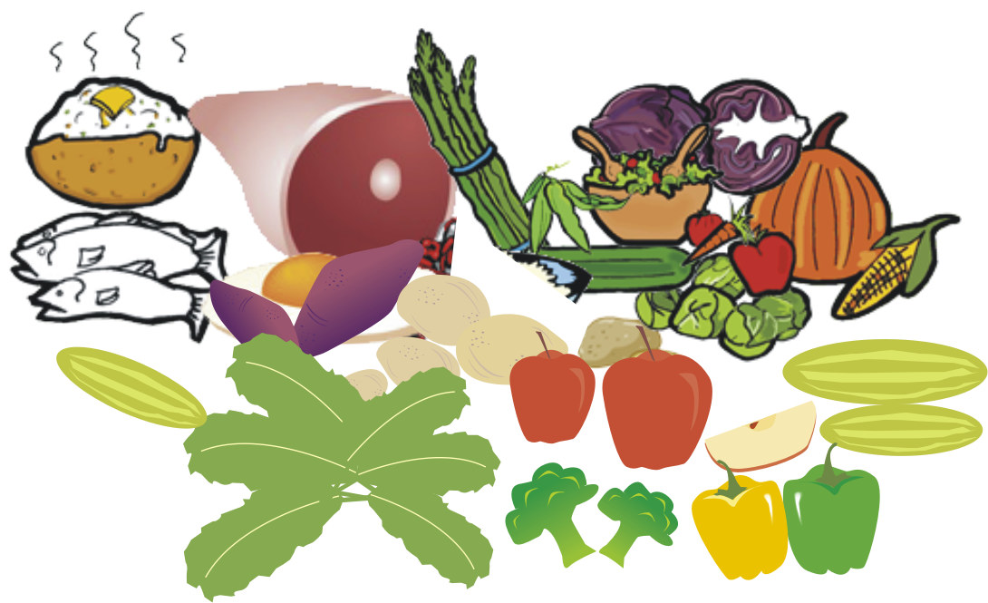
Food Sources
Animal source-Liver,meat products and egg yolk
Vegetable source-Green leafy vegetables,apricots,dates.
Jaggery and molasses

Slide 73
Factors affecting iron absorption
Form of dietary iron-Haem iron from animal source and non haem iron from vegetable source
Ferric ofr ferrous
Amount of acid in stomach
Iron stores of body
Vitamin C and protin
Folic acid and vit B12

Slide 74
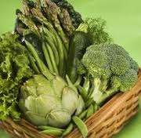
Factors inhibiting iron absorption
Phytic acid found in cereals and dry fruits
Oxalic acid found in some vegetables
Tanins in ragi,jowar,tea coffee,beans
Calcium
Fat
Fibre
Parasitic infestation

Slide 75
Recommended allowances
Adult Man 28 mg
Women 30 mg
Pregnant women 37.5mg
Lactating women 30 mg
Children 1-3 years 11.5 mg
4-6 years 18.4 mg
7-9 years 26 mg
10-12years boys 34 mg
girls 18.9 mg
Adolescents
13-15years boys 41.5mg
girls 28 mg
16-18years boys 49.5mg
girls 29.9 mg

Slide 76
Effects of iron deficiency
Deficiency of iron in the body may result from
1. Inadequate intake
2. Poor absorption of iron
3. Abnormal loss of blood from body
Stores of iron are depleted, blood haemoglobin levels come down resulting in fatigue leading to anaemia.

Slide 77
Anaemia
Level of haemoglobin in blood is an index to know status of iron in the body.
Normal level in adult man :14-16gm/100ml of blood
In adult women:12-14/100ml of blood
Anaemia is a condition in which there is reduction in the total circulating haemoglobin

Slide 78
Anaemia due to iron deficiency
Reasons:
Lack of iron rich foods
Poor absorption
Poor absorption of iron from diet
Excessive loss of iron from body
Destruction of red cells
Parasitic infestation
Hypoacidity

Slide 79
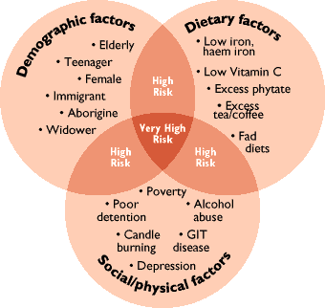

Slide 80
Types Of Anaemia Due To Iron Deficiency
Hypochromic microcytic anaemia-size of red blood cells decrease though their number does not change –reduced iron content and colour becomes light.
Hypochromic macrocytic anaemia-size of red blood cell increases but number is reduced.Haemoglobin content –low.It occurs due to combined deficiency of iron ,folic acid and vitamin B12-commonly during pregnancy

Slide 81

Symptoms Of Anaemia
Fatigue
Loss of appetite
Breathlessness
Giddiness
Pallor of skin
Smooth tongue
Spoon shaped nails
PICA –eating of non-edible food-chalk
Severe cases swelling on face,body,limbs and if not treated –heart failure leading to death

Slide 82
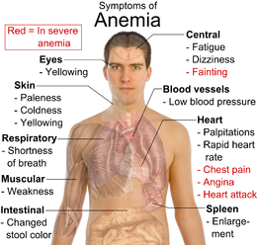

Slide 83
Treatment of Anaema
Iron Tablets
In severe conditions blood transfusion
If hookworm infestation -treatment immediately
Inclusion of iron rich foods eg.green leafy vegetables,egg yolk ,meat etc
To improve absorption vitamin C and protein should be added
Factors which interfere with iron absorption should be avoided.
Increase bioavailability of iron eg sprouting of pulses-increase in vitamin B complex and C
Prevention of iron loss-periodical deworming in areas where parasitic infestation occur

Slide 84
Other Types Of Anaemia
Pernicious anaemia—genetic disorders. intrinsic factor is not produced in sufficient amount in stomach as a result B12 is not absorbed.Reduced HCL also affects. Occurs in vegetarians middle age and elderly persons.
Megaloblastic anaemia results from deficiency of folic acid.Reduction in number of red blood cells large cells with low haemoglobin.Found in scurvy-reduction in conversion of folic acid to its active form folinic acid

Slide 85
Sickle cell anaemia-genetic disease found in blacks. Abnormal levels of haemoglobin causing red cells to assume a sickle shape-makes them unable to move through capillaries leading to thrombosis.
Normocytic anaemia-Size of red blood cell is normal but haemoglobin content is low.Can be congenenital or acquired (infection).
Sideroblastic anaemia-group of blood disorders in which body has snough iron but unable to use to make haemoglobin-iron accumulates in red cells giving ringed appearance.

Slide 86

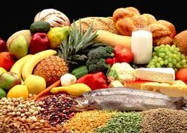

Slide 87
Thank You
Dr. Amarjeet Kaur
Associate Professor,
Deptt. Of Home Science
PGGCG, Sector 42, Chandigarh.

