Slide 1
Scales of Fishes
By:
Dr.Rashmi kohli

Slide 2
1. Placoid Scales: Mainly occur in Cartilagenous fishes. They consist of rhomboidal basal plate and spine. The basal plate is formed of calcified material resembling bone. It is attached to the stratum compactum of the dermis by Sharpey’s fibres. The spine is made up of Dentine having fine canaliculi and covered by harder material Vitrodentine. They have 3-5 teeth at the free end and called tridentate or pentadentate. The spines are directed backwards. A perforation in basal plate leads into pulp cavity having pulp which consists of odontoblasts (dentine forming cells), artery and vein and nerve fibres.
They are replaced when worn out.
They are homologous with the vertebrate teeth.

Slide 3
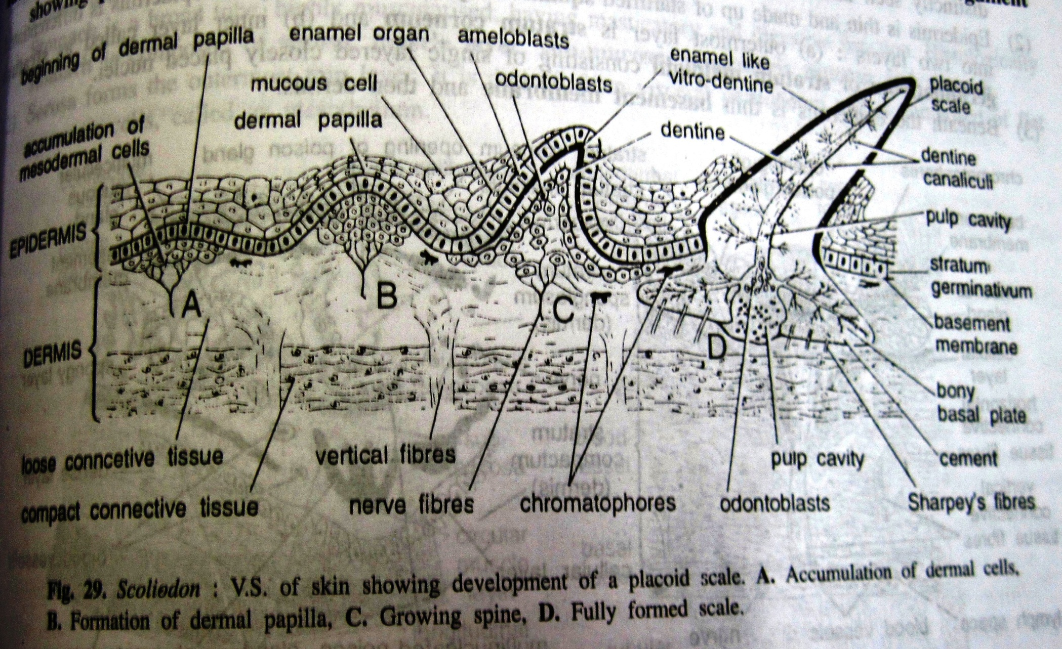

Slide 4
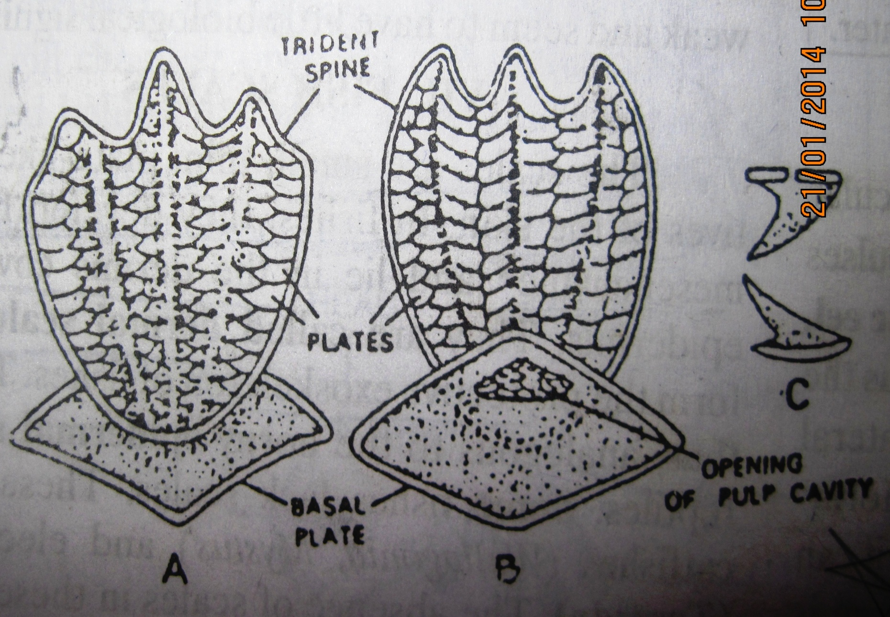

Slide 5
2. Cosmoid Scales: They were present in extinct lungfishes and only in Latimeria (living form).
They are rhomboid in shape.
They have 4 layers: innermost layer of compact bone called Isopedine, second layer of vascular spongy bone, third layer of hard dentine like material called Cosmine and outer most fourth thin layer of enamel like material Vitrodentine.

Slide 6
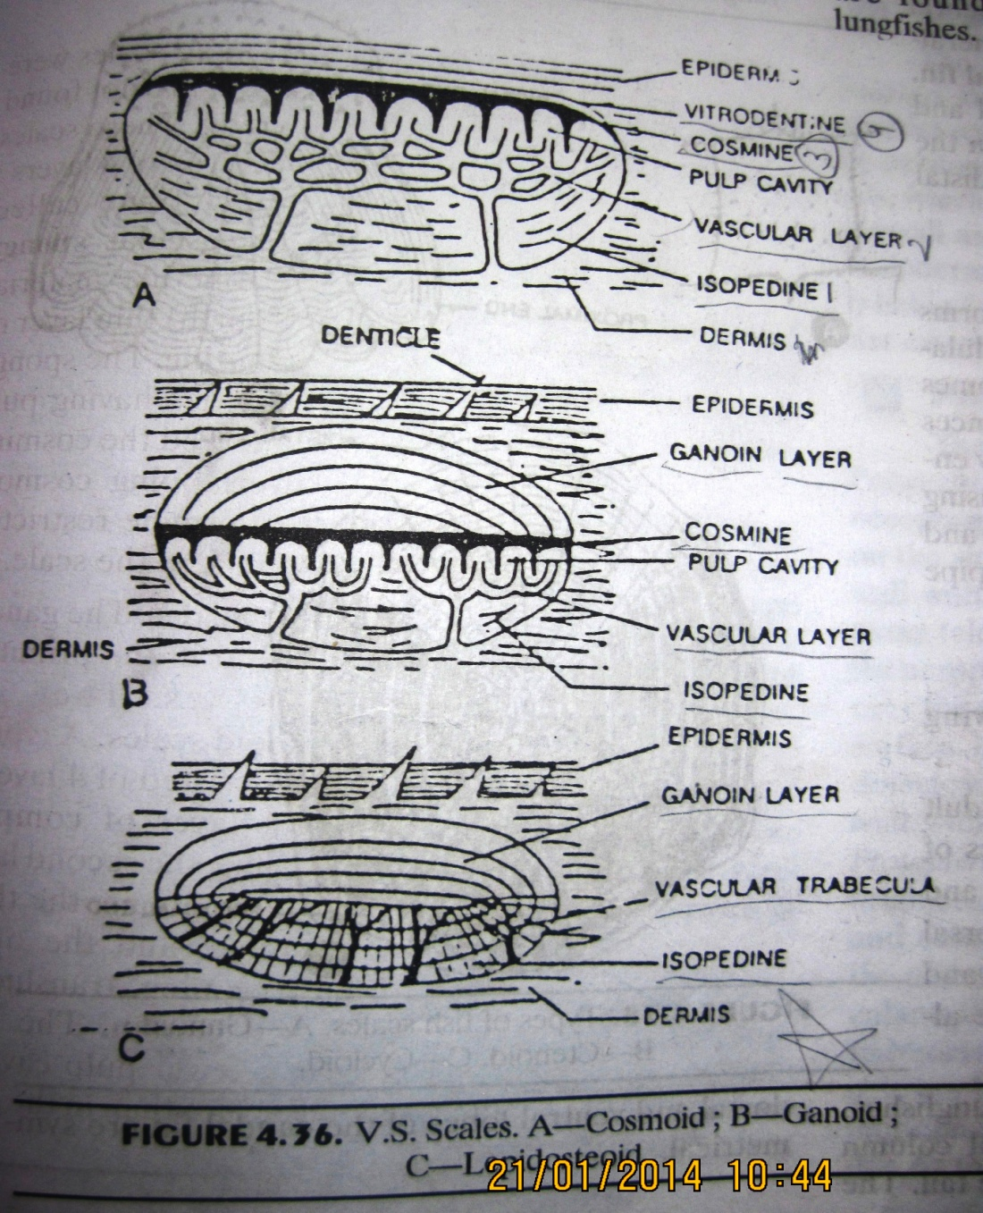

Slide 7
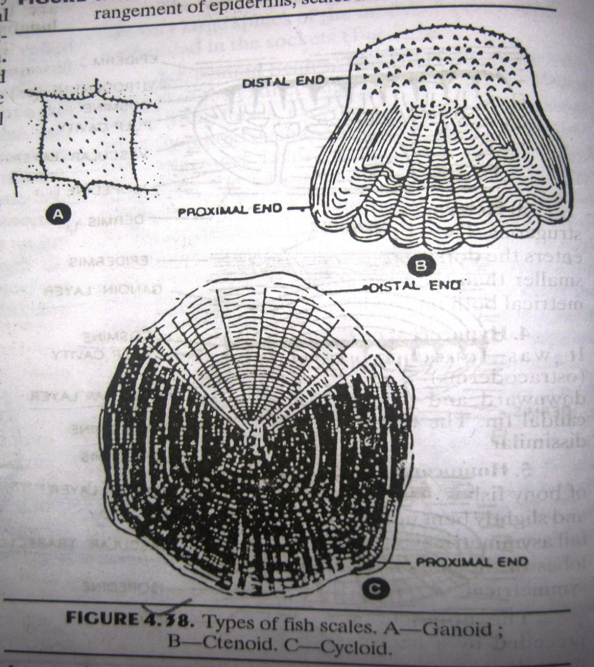

Slide 8
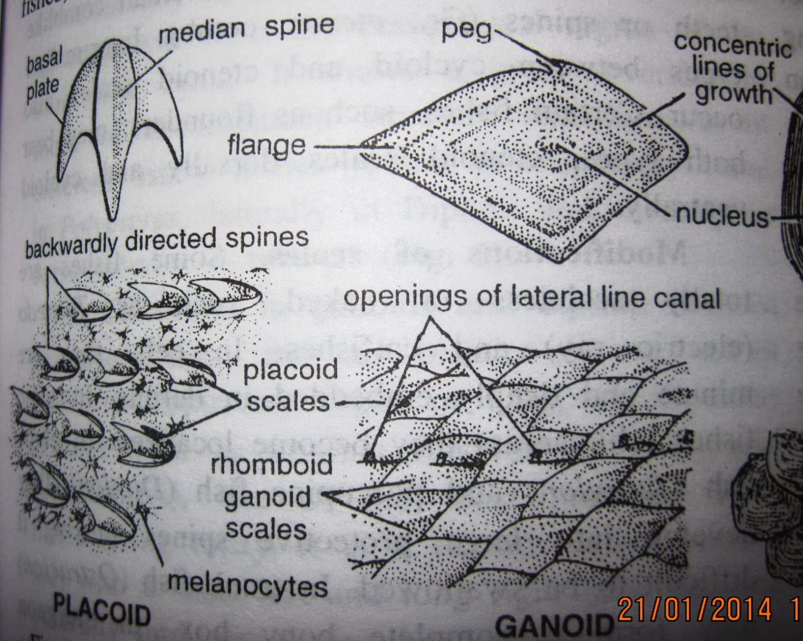

Slide 9
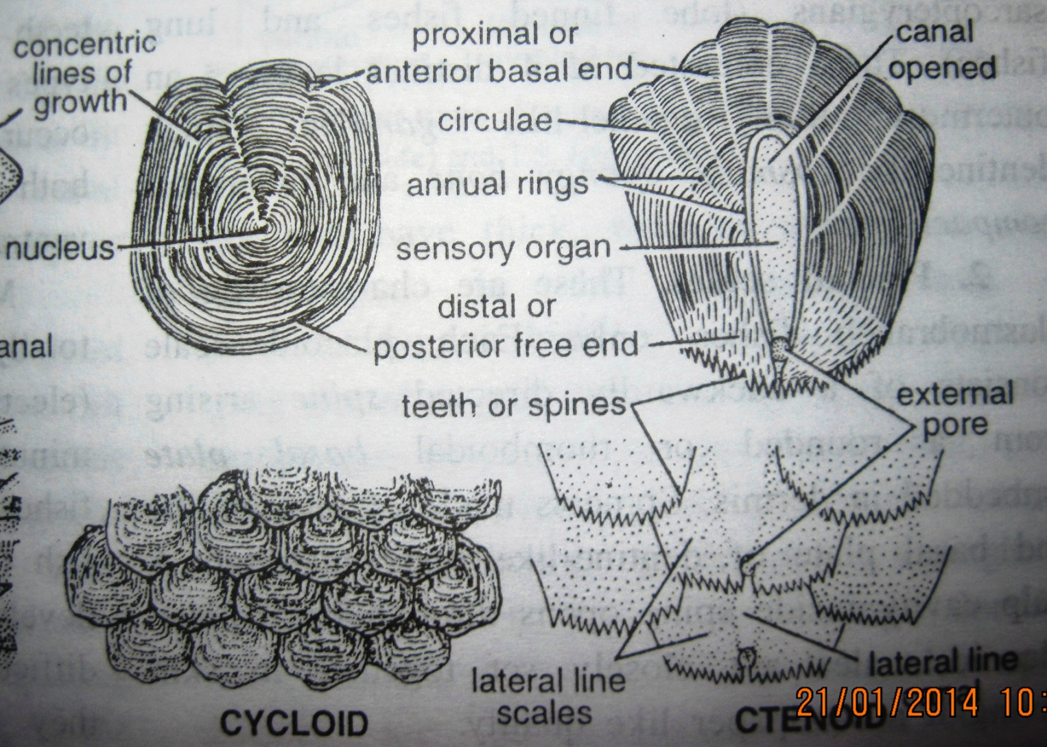

Slide 10
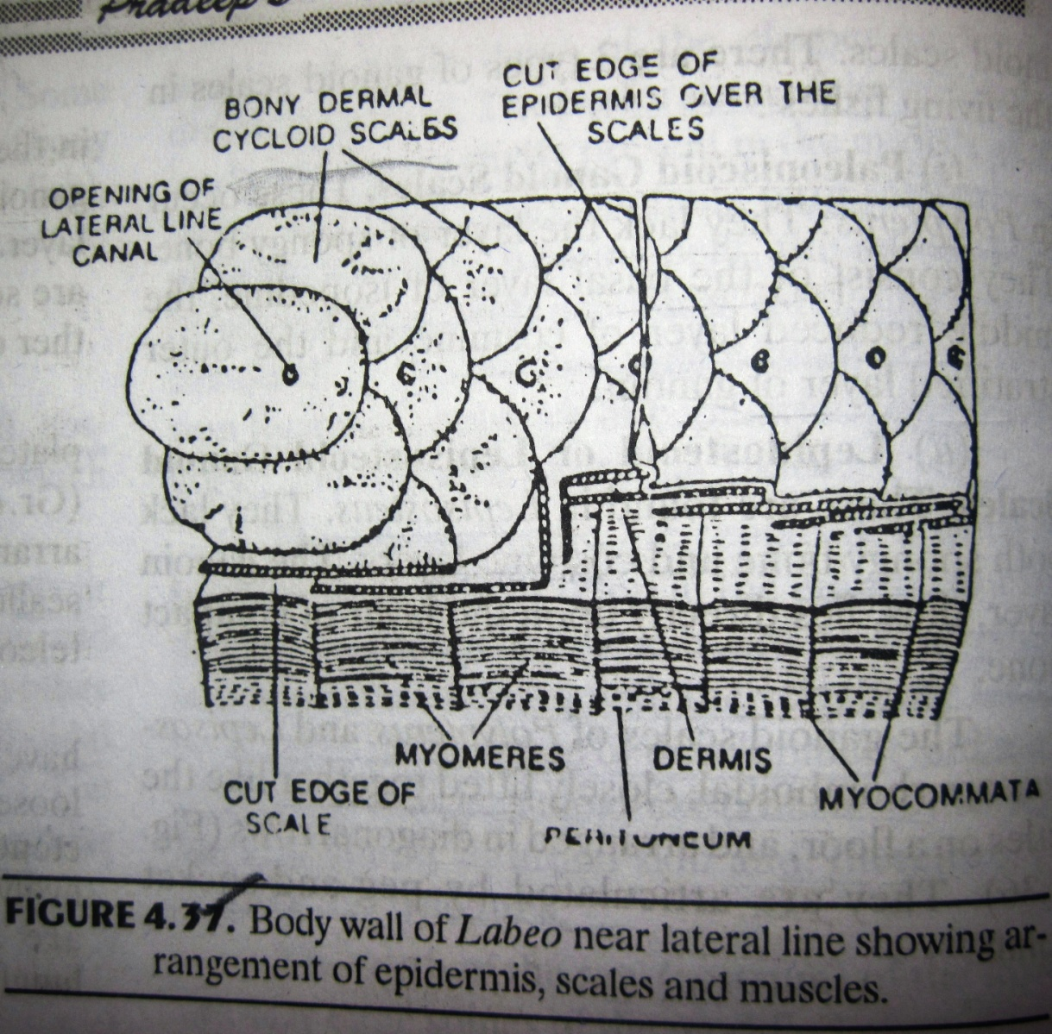

Slide 11
3. Ganoid Scales: Found in primitive ray finned fishes. They are modified Cosmoid Scales. They consist of 4 layers: innermost compact bone or Isopedine, second layer of spongy bone, third layer of Cosmine and outer most layer of shining translucent material ganoin.
3 types of ganoid scales:
i.) Paleoniscoid Scales: E.g. Polypterus. They lack layer of spongy bone. They have basal layer of isopedine, reduced middle layer of cosmine and outer most Ganoin.
ii.) Lepidosteoid Scales: e.g. Lepisosteus. They lack both spongy bone and cosmine layer.
Both the above scales are rhomboidal, closely fit together like tiles of floor.
iii.) Leptoid Scales: E.g. Bony fishes.They have lost the ganoin layer also and consist only of isopedine layer. This layer lacks bone cells so that scales re soft dermal plates. They are further of 2 types: a.) Ctenoid Scales: They are thin, translucent with comb like projections on free ends.
b.) Cycloid Scales: E.g. Modern lungfishes. Circular having smooth free edges. They are loosely attached and more primitive than ctenoid scales.

Slide 12
1. Some fishes like (Flounder) have ctenoid on upper and cycloid on lower surface.
2. Scales on lateral sides are perforated to allow stimulation of receptors.
3. Fish scales aren’t shed like reptilian scales.
4. Torpedo is totally scaleless.
5. In Eel they are minute and deeply embedded in dermis.
6. In Tetradon and Diodon they develop into large protective spines.
7. In Acipenser stout bony plates or bony armour is formed.
8. Shark teeth are modified placoid scales.

Slide 13
References:
Vertebrates by Kotpal
Chordates by Pradeep’s

