Slide 1
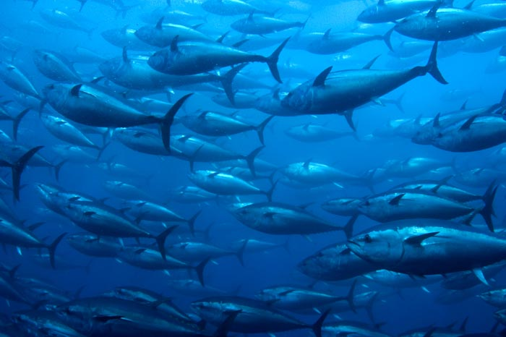
FISH MIGRATION
DR. DALIP KUMAR

Slide 2
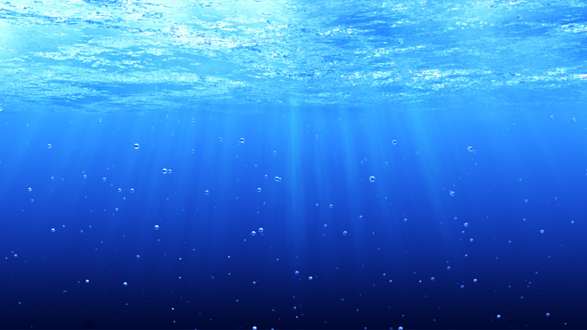
Basic Terms
Migration is the movement of large number of animals from one place to another for feeding, reproduction or to escape weather extremes.
Shoaling:- When large no. of fishes come together and move socially, it is called as shoaling, Eg. Tuna, Anchovies.
Schooling:-Migrating fishes exhibit high degree of coordination in their movements and carry out synchronized maneuvers to produce different types of shapes. This is called schooling.eg. Forage fishes

Slide 3
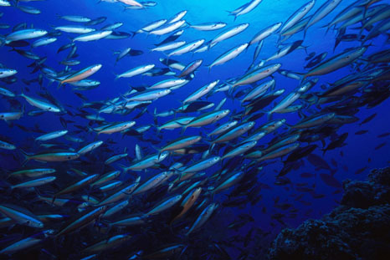

Slide 4
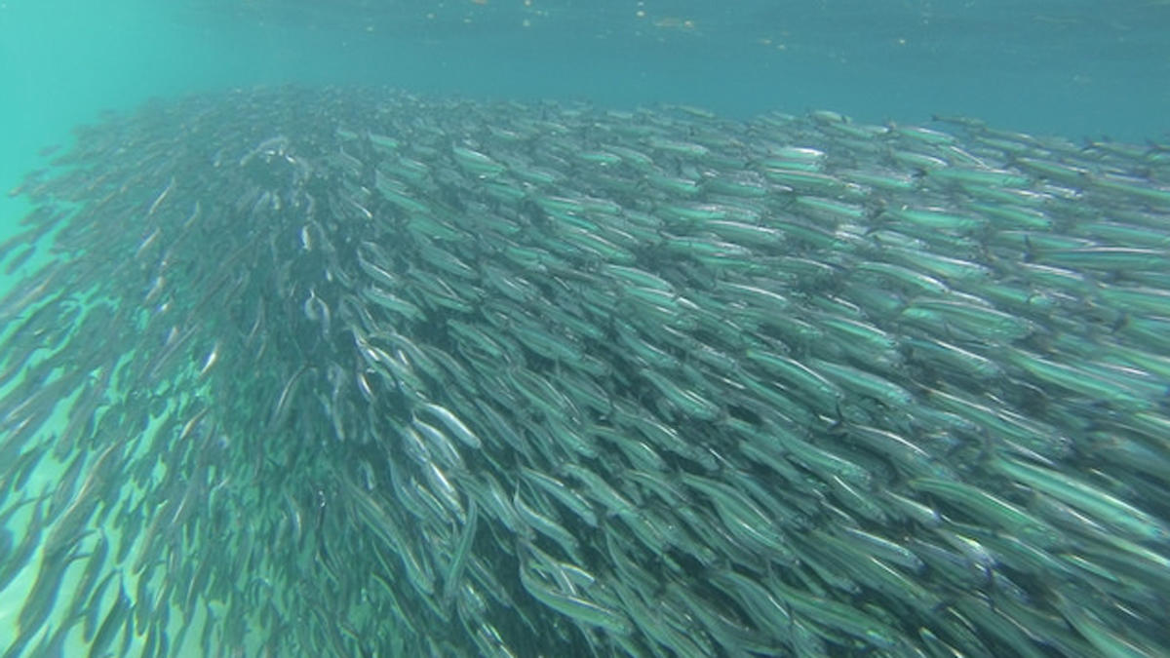

Slide 5
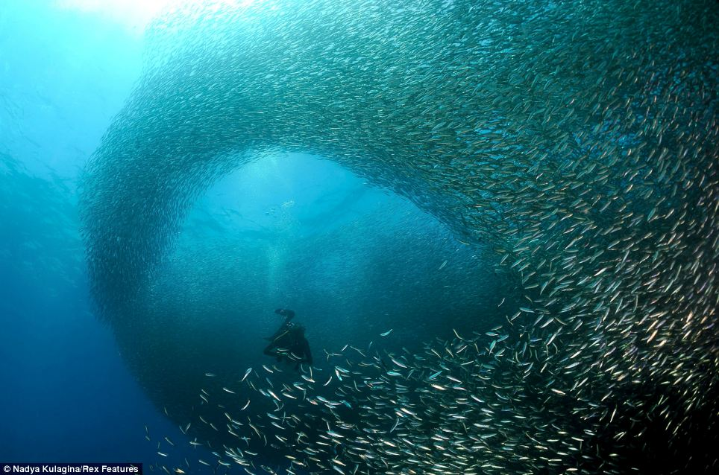

Slide 6
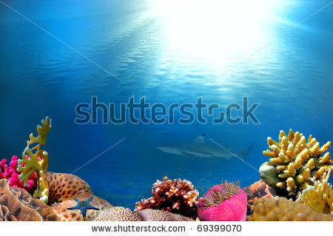
Fishes live in two different types of aquatic habitats:-
Freshwater Habitat
Marine Habitat
Migration is the movement of large number of animals from one place to another for feeding, reproduction or to escape weather extremes.
Fishes live in two different types of aquatic habitats :
1. Freshwater Habitat
2. Marine Habitat

Slide 7
On the basis of cause, fish migration is of following types :
Feeding or alimental migration:- It takes place in fishes for feeding.
Examples:- Salmons, cods and sword fish migrate for food.
Spawning migration :- It takes place in breeding season in those fishes which have spawning grounds far away from the feeding places.
Examples:- Eels, salmons and a large no. of riverine fishes.
Juvenile migration:- It involves larval stages of fishes which hatch in spawning grounds and migrate long distances to reach the feeding habits of their parents.
Recruitment migration:- It takes place when large no. of larvae move from nursery habitat to the habitat of adults.
Seasonal migration:- It takes place in fishes that inhabit arctic areas where in summer climate is conducive and food abundant but as winter approaches temperature fall below zero and food becomes scarce. Hence, fishes must migrate towards subtropical and tropical areas to escape extremes of weather conditions.

Slide 8
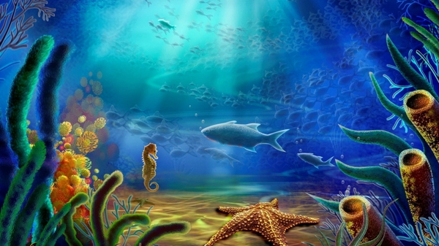
FISH MIGRATION
ON THE BASIS OF HABITAT CHANGE
POTAMODROMOUS
OCEANODROMOUS
DIADROMOUS
CATADROMOUS
FROM FRESH WATER TO SEA WATER
ANADROMOUS
FROM SEA WATER TO FRESH WATER

Slide 9
Different types of fish migration on the basis of habitat:
Potamodromous Migration:-When fishes migrate from one freshwater habitat to another in search of food or spawning, it is called as potamodromous migration.
Fishes also migrate to lay eggs in places where oxygen concentration in water is more and where there is abundance of food for juveniles when they hatch from eggs.
Example:- Common Asian Carps

Slide 10
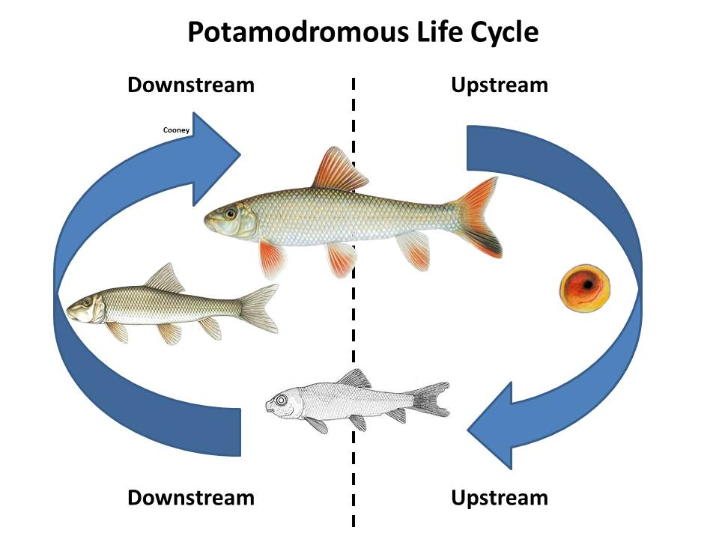

Slide 11
Oceanodromous Migration:- This migration is from sea water to sea water.
Example:-There are about 12,000 marine species that regularly migrate within sea like herrings, sardines, mackerels, cods, roaches and tunas.
Diadromous migration:- When fishes can migrate from fresh water to sea water or from sea water to fresh water, it is called diadromous migration.
It involves 120 species of fishes that are capable of overcoming osmotic barriers and migrate in these habitats.

Slide 12

Diadromous Migration is of two types:
1.Catadromous Migration
2.Anadromous Migration

Slide 13
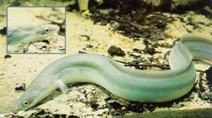
Catadromous Migration:- This type of migration involves movement of large number of fishes from fresh water to sea water, generally for spawning as happens in the case of Anguilla(eels).
Before migration the following changes take place in their bodies:
They deposit large amount of fat in their
bodies which serves as reserve food
during the long journey.
Color changes from yellow to metallic
silvery grey.
Digestive tract shrinks and feeding stops.
Eyes are enlarged and vision sharpens.
Other sensory organs also become sensitive.
Skin becomes respiratory.
Gonads get matured and enlarged.
They become restless and develop strong
urge to migrate in groups.

Slide 14
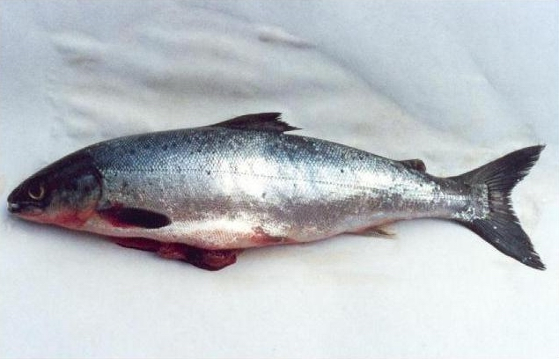
Anadromous Migration:- It involves migration of fishes from sea water to fresh water.
Example:- Salmon and trout
To maintain homeostasis, freshwater species have special adaptations for retaining ions and getting rid of excess water.
They actively take in ions across their gills and skin, a process that requires energy.
To get rid of excess water they excrete nitrogenous waste products in great quantities in the form of highly diluted urine.

Slide 15
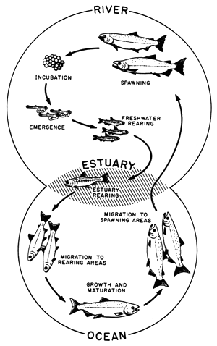
DIADROMOUS MIGRATION
Catadromous
Migration
Anadromous
Migration

Slide 16
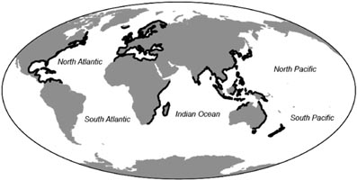
Oceanodromous fish migrating area
Catadromous Fish Migrating area
Potamodromous fish migrating area
Anadromous fish migrating area

Slide 17
Vertical Migration
The movement of fishes towards upper surface of sea during night and towards bottom during day fro various endogenous and exogenous reasons is called vertical migration.
Diet vertical migration is a common behavior; many marine species move to the surface at night to feed and then return to the depths during daytime.
Factors playing role in Vertical Migration:-
Endogenous factors:- which originate from organism itself like sex, age biological rhythms, etc.
Exogenous factors:- These are the environment factors acting on the organisms such as light, gravity, oxygen, temperature, predator-prey interactions etc.

Slide 18
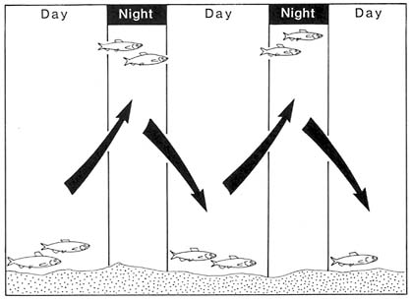

Slide 19
Significance of Vertical Migration
Predator Avoidance:- Organisms come up to shallow waters at night to feed while it’s dark out because their predators cannot see them as easily as in day.
Metabolic Advantage:-By feeding in the warm surface waters at night and residing in the cooler deep waters during the day they can conserve energy. Alternatively, organisms feeding on the bottom in cold water during the day may migrate to surface waters at night in order to digest their meal at warmer temperatures.
Dispersal and Transport:- Organisms can use deep and shallow currents to find food patches or to maintain a geographical location.
Avoid UV Damage:-The sunlight can penetrate into the water column. If an organism, especially something small like a microbe, is too close to the surface , the UV can actually damage them. So they want to avoid getting too close to the surface, especially during daylight.
Better Opportunities for Growth and Reproduction.

Slide 20
Other important facts
Forage fish (prey fish) are small fish which are preyed upon by large predators for food.
They migrate in schooling manner. Their schools become immense shoals which are concentrated fuel resources for the great marine predators.

Slide 21
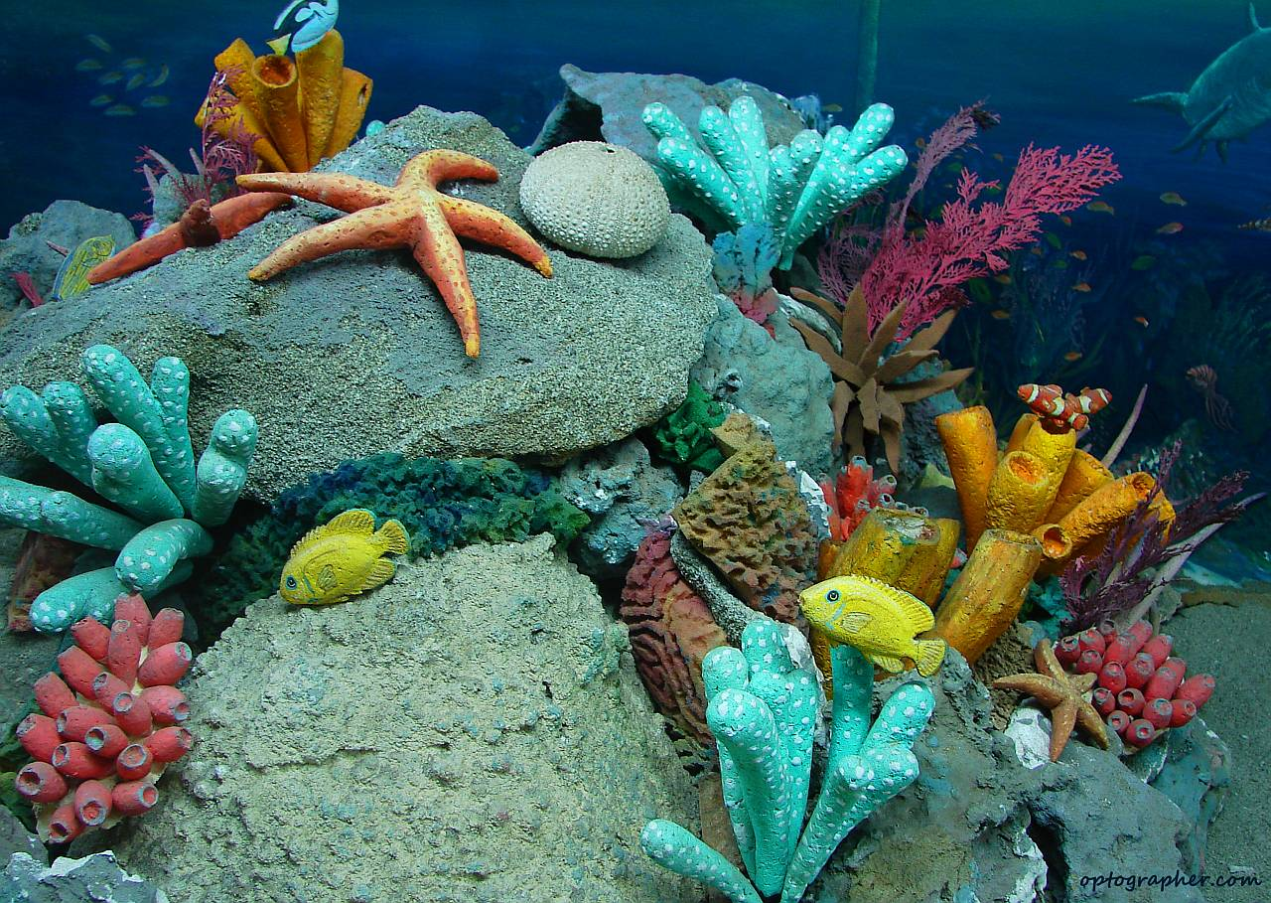
Significance of fish migration
Spawning
To achieve better growth rates
Greater reproductive success
Temporal and spatial aggregations of fishes.
To escape temperature extremes.
Spawning
To achieve better growth rates
Greater reproductive success by moving between areas.
Temporal and spatial aggregations of fish.
To escape temperature extremes.

Slide 22
Need to understand fish migratory behavior
Migration makes fish more vulnerable to exploitation(fishing). This is clearly of significance for commercial fisheries, and fisheries have traditionally exploited this migratory and aggregating behavior in salmon and cod.

