Slide 1
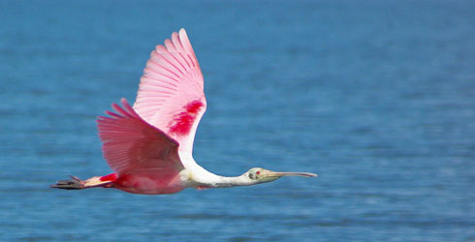
BIRD MIGRATION
DR. DALIP KUMAR

Slide 2
INTRODUCTION
WHAT IS BIRD MIGRATION?
Periodic movement of birds from one place to another and back.
Emigration- outward migration (from feeding ground to breeding grounds)
Immigration- inward migration (from breeding grounds to feeding grounds)

Slide 3
WHY DO BIRDS MIGRATE?
For food and safe place to breed. Birds which breed in the summer in the extreme north such as the Arctic are benefitted from an abundance of food as plants and insects flourish in the long daylight hours; because few large permanent predators can survive the harsh winter.
Behavior is inherited; however, will not migrate in the absence of certain physiological and environmental cues. In the late summer, the decrease in sunlight stimulates a migrating bird's pituitary gland to produce the hormone. The hormones, in turn, cause the birds to accumulate large amounts of fat just under the skin, providing them with enough energy for the long migratory flights. The exact time of departure, however, is dictated not only by the decreasing sunlight and hormonal changes, but also by such conditions as the availability of food and the onset of cold weather.

Slide 4
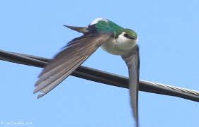
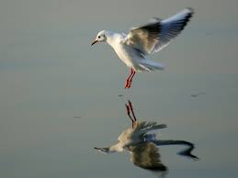
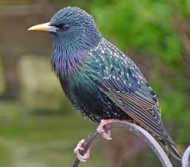
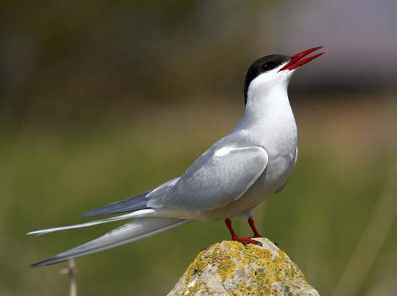
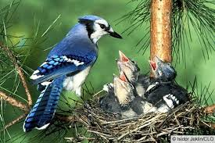
TYPES OF MIGRATION
Altitudinal migration (eg; Violet
Green Swallows)
Latitudinal migration (eg; Seashore)
Longitudinal migration (eg; Starling)
Total migration (eg; Arctic Tern)
Partial migration (eg; Blue jays)

Slide 5
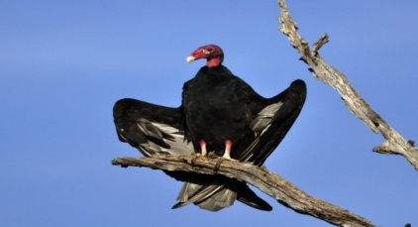
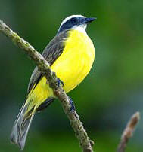
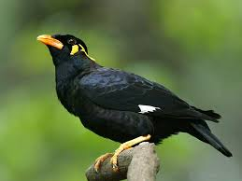

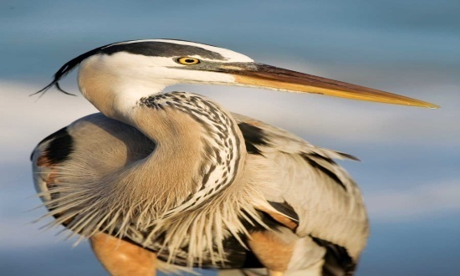
Diurnal migration (eg; Vultures)
Nocturnal migration (eg; Flycatcher)
Daily migration (eg; Mynas)
Seasonal migration (eg; Snow Bunding)
Irregular migration (eg; Heron)

Slide 6
ADVANTAGES
Migration makes it possible for some species to inhabit two different areas during the seasons when each presents favorable conditions. By withdrawing in the spring to regions uninhabitable earlier in the year, migrant species are generally assured of adequate space and ample food upon their arrival in the winter-freed North, and those non migratory kinds, which stay behind to nest, are also assured of ample space for these activities.
Every pair of birds requires a certain amount of territory for the performance of its reproductive duties. This territory must be large enough to provide adequate food, not only for the parent birds but also for the lusty appetites of their young. In the Arctic summer, 24 hours of daylight allow the young to feed or be fed almost continuously and rapid growth is apparent.
The tendency of some birds to move southward at the approach of winter is not always due to seasonal low temperatures. The main consideration , is depletion of the food supply, caused by either the disappearance or hibernation of insects or the mantle of snow or ice that prevents access to seeds and other food found on or close to the ground or submerged in water. Also, shortened hours of daylight may restrict the ability of birds to obtain sufficient food at a time when low temperatures require increased energy to maintain body heat.

Slide 7
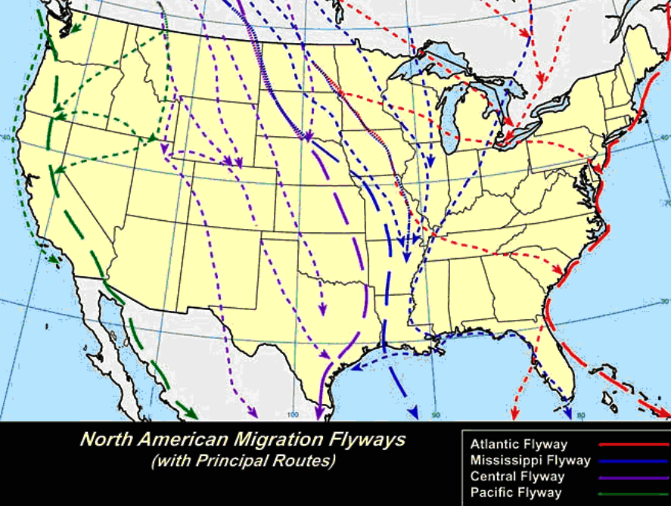
FLYWAYS
Usually birds migrate along the flyway.
The major wintering areas for North American migrating birds are the southern United States and Central America.
Four major flyways south: the Atlantic flyway, the Mississippi flyway, the Central flyway, and the Pacific flyway.

Slide 8
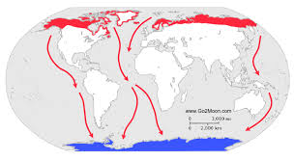
The major wintering bird, the Arctic Tern, can be found south of the tips of South America, Africa and Australia at one end of its migratory route. That means it ranges from near the Antarctic Ocean all the way up to the Arctic.
The most common pattern involves flying north in the spring to breed in the temperate or Arctic summer and returning in the autumn to wintering grounds in warmer regions to the South.

Slide 9
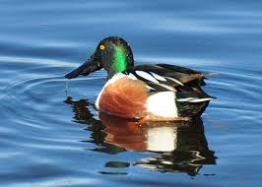
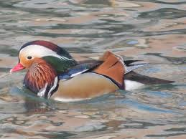
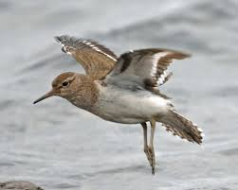
Sometimes, journey are not termed “ true migration” because they are irregular or in only one directions
Northern Shoveler
Eurasian Wigeon
Sandpiper
These birds are commonly spotted at Sukhna lake, Chandigarh

Slide 10
PHYSIOLOGY AND CONTROL
TIMING
The primary physiological cue for migration are the changes in the day length. These changes are also related to hormonal changes in the birds. In the period before migration, many birds display migratory restlessness, as well as physiological changes such as increased fat deposition.
ORIENTATION AND NAVIGATION
Landmarks- topographical features like rivers, valleys, oceans, deserts, etc
Earth magnetic field
Telluric currents
Experience
Sun- birds uses sun as a compass
Stars
Internal clock and compass
Olfactory cues

Slide 11
VAGRANCY
Migrating birds can lose their way and appear outside their normal ranges. This can be due to flying past their destinations as in the "spring overshoot" in which birds returning to their breeding areas overshoot and end up further north than intended.
A related phenomenon called "abmigration" involves birds from one region joining similar birds from a different breeding region in the common winter grounds and then migrating back along with the new population.
MIGRATION CONDITIONING
It has been possible to teach a migration route to a flock of birds, for example in re-introduction schemes. After a trial with Canada geese Branta canadensis, microlight aircraft were used in the US to teach safe migration routes to reintroduced whooping cranes Grus americana.

Slide 12
THREATS AND CONSERVATION
Sadly, in addition to surviving storms and bad weather, exhaustion and other natural obstacles, migrating birds are increasingly face human threats.
Habitat destruction that affects staging posts handicap their ability to re-fuel. These include draining wetlands, cutting down forests.
Pollution of the sea, water and air also affects them.
Migrating birds are also distracted and killed by lit-up skyscrapers, lighthouses and other unnatural man-made formations that mislead them. Sadly, many migrating birds are also hunted, for food and for sport.

Slide 13
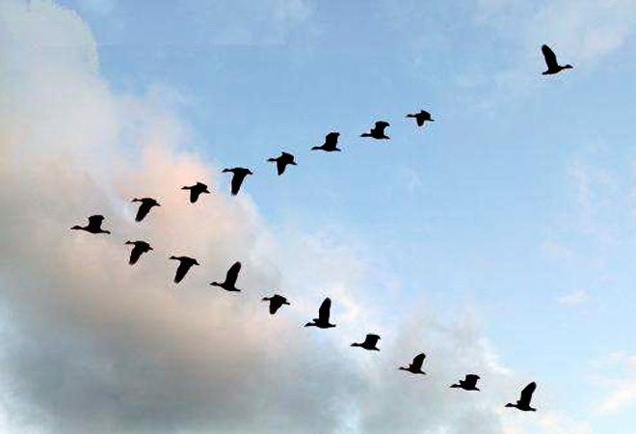
THANK YOU

