Slide 1
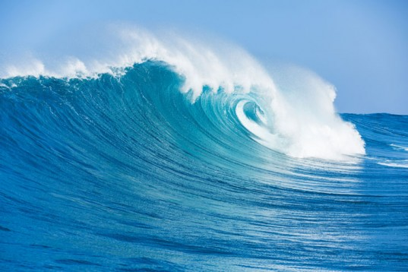
AQUATIC ADAPTATIONS
DR.DALIP KUMAR

Slide 2
AQUATIC ADATATIONS
Primary Aquatic Adaptations
Secondary Aquatic Adaptations

Slide 3
Primary Aquatic Adaptations
Streamlined Body
Lateral line for equilibrium
Nicitating membrane is presrent in eyes for clear vision in water
Presence of swim bladder in bony fishes serve as accessory respiratory organ as well as hydrostatic organ
Anal fin helps to stabalize the fish while swimming
Absence of pinna
Presence of scales

Slide 4
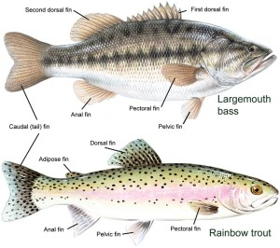

Slide 5
Secondary Aquatic Adaptations
WHALE :
Flippers help to navigate and steer
Flukes used for propulsion
Small eyes and secrete oil used to protect eyes from debris
Presence of blowhole which act as a airway passage for breathing
Dorsal fin maintains equilibrium
Presence of baleen

Slide 6
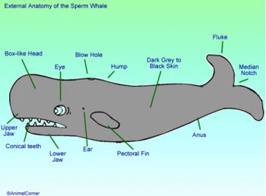
WHALE

Slide 7
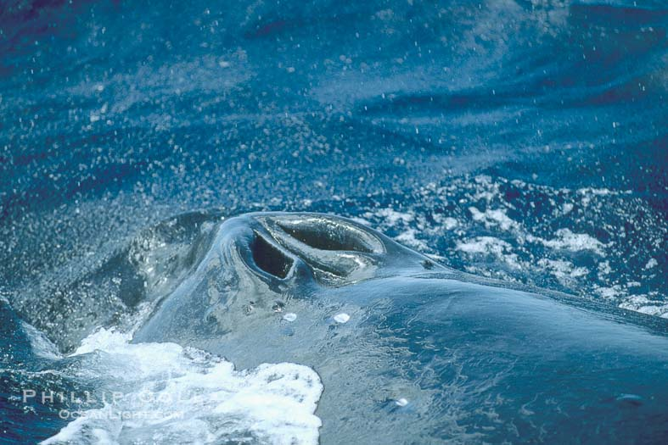
Blowhole

Slide 8
Secondary Aquatic Adaptations
  TURTLE :
Presence flippers instead of feet
Front flippers help to generate thrust and back flippers used for steering
Respiration by special organ, in cloaca finger like projections are present called papillae which increases the surface area so that turtle can take up oxygenated water through it

Slide 9
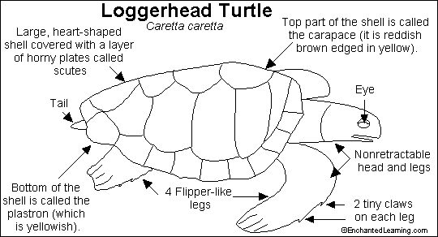

Slide 10
Secondary Aquatic Adaptations
DUCK (WEBBED FEET )
Webbed feet helps to swim faster and act as paddle
Waterproof feathers
Light weight skeleton
Stiff flexible feathers on the tip of their wings so they can easily push the air back creating thrust
Strong beak to gather and hold food
Presence of preen glands used for oiling

Slide 11
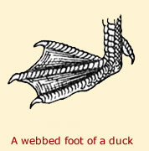

Slide 12
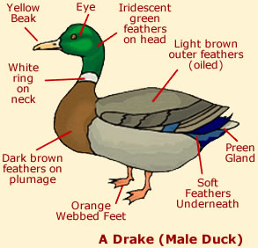

Slide 13
Secondary Aquatic Adaptations
DUCK BILLED PLATYPUS
Tail is made up of fatty tissue that is used to store energy
Tail helps in insulation also
Tail is used for steering while swimming
Streamlined and dorso-ventrally compressed body
Rubbery snout
Nostrils are located on the dorsal surface of the snout

Slide 14
