Slide 1
VIRTUAL MEMORY

Slide 2
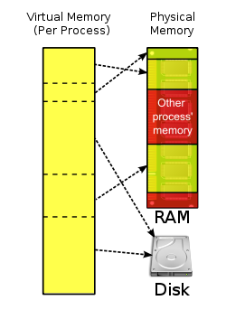
Virtual Memory
It is a computer system technique which gives an application program the impression that it has contiguous working memory (an address space), while in fact it may be physically fragmented and may even overflow on to disk storage.
computer operating systems generally use virtual memory techniques for ordinary applications, such as word processors, spreadsheets,multimedia,players accounting, etc., except where the required hardware support (memory management unit) is unavailable or insufficient.

Slide 3
Memory is used in
Computer
Mobile
Printer
Digital Camera
CD/DVD Player
Many other appliances like TV, Washing Machine, Oven, Digital Diaries etc.

Slide 4
The Paging Process
When the CPU generates a memory address, it is a logical (or virtual) address
  The first address of a program is 0, so the logical address is merely an offset into the program or into the data segment
    For instance, address 25 is located 25 from the beginning of the program
    But 25 is not the physical address in memory, so the logical address must be translated (or mapped) into a physical address

Slide 5
  Assume memory is broken into fixed size units known as frames (1 page fits into 1 frame)
    We know the logical address as its page # and the offset into the page
  We have to translate the page # into the frame # (that is, where is that particular page currently be stored in memory – or is it even in memory?)
    Thus, the mapping process for paging means finding the frame # and replacing the page # with it

Slide 6
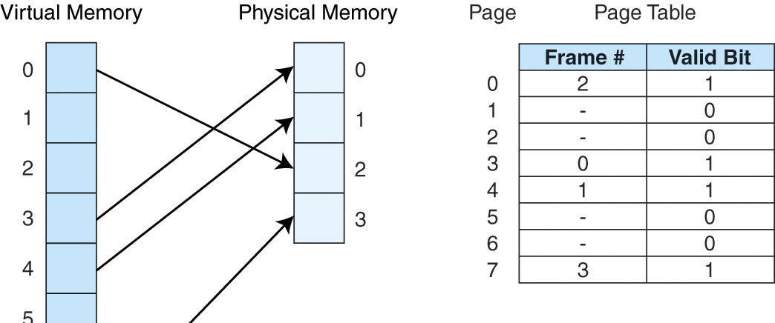

Slide 7
Here, we have a process of 8 pages but only 4 physical frames in memory – therefore we must place a page into one of the available frames in memory whenever a page is needed
At this point in time, pages 0, 3, 4 and 7 have been moved into memory at frames 2, 0, 1 and 3 respectively
This information (of which page is stored in which frame) is stored in memory in a location known as the Page Table. The page table also stores whether the given page has been modified (the valid bit – much like our cache)

Slide 8
Page Faults
Just as cache is limited in size, so is main memory – a process is usually given a limited number of frames
What if a referenced page is not currently in memory?
  The memory reference causes a page fault
    The page fault requires that the OS handle the problem
  The process’ status is saved and the CPU switches to the OS
  The OS determines if there is an empty frame for the referenced page, if not, then the OS uses a replacement strategy to select a page to discard

Slide 9
    if that page is dirty, then the page must be written to disk instead of discarded
  The OS locates the requested page on disk and loads it into the appropriate frame in memory
  The page table is modified to reflect the changePage faults are time consuming because of the disk access – this causes our effective memory access time to deteriorate badly!

